Slide 1
Java is pure object oriented programming or not?

Slide 2
Java is pure object oriented programming or not?
Java is not considered as pure object oriented programming language because several oops features (like multiple inheritance, operator overloading) are not supported by java moreover we are depending on primitive data types which are non objects.

Slide 3
What is max and min value of Byte?

Slide 4
What is max and min value of Byte?
Maxvalue: +127 Minvalue:-128

Slide 5
What is max and min value of short?

Slide 6
What is max and min value of short?
Min value-32768 to Max value32767

Slide 7
What is max and min value of int?

Slide 8
What is max and min value of int?
-2147483648 to 2147483647

Slide 9
When to use float and double data types?

Slide 10
When to use float and double data types?
5 to 6 Decimal
14 to 15 Decomal

Slide 11
Which of the following the is correct?
boolean b=true;
boolean b=True;
b="True“;
types boolean b=0;

Slide 12
What is the output of following ?
char ch1=97; char ch2=65536;

Slide 13
Fill in the blanks ?
Any sequence of characters with in double quotes is treated as ------literal.

Slide 14
Fill in the blanks ?
Any sequence of characters with in double quotes is treated as string literal.

Slide 15
Only java reserved words
final, finally, finalize

Slide 16
Only java reserved words
break, continue, return, exit

Slide 17
Only java reserved words
goto, constant

Slide 18
Only java reserved words
byte, short, Integer, long

Slide 19
Only java reserved words
final, finally, finalize

Slide 20
Only java reserved words
extends, implements, imports

Slide 21
Only java reserved words
finalize, synchronized

Slide 22
Only java reserved words
instanceof, sizeOf

Slide 23
Only java reserved words
new, delete

Slide 24
“enum” this keyword introduced which version?
1.1
1.4
1.6
1.5

Slide 25
All reserved words in java contain only lowercase alphabet symbols.
True
False

Slide 26
useless objects is the responsibility of?

Slide 27
useless objects is the responsibility of?
Garbage Collection

Slide 28
What is Arrays?

Slide 29
What is Arrays?
An array is an indexed collection of fixed number of homogeneous data elements. The main advantage of arrays is we can represent multiple values with the same name so that readability of the code will be improved.

Slide 30
What is Arrays?
int[][] a;
int [][]a;
int a[][];
int[] []a;
int[] a[];
int []a[];

Slide 31
What is the output?
Example: int[] x=new int[3]; System.out.println(x.length()); System.out.println(x.length);

Slide 32
Anonymous Arrays?

Slide 33
Anonymous Arrays?
Sometimes we can create an array without name such type of nameless arrays are called anonymous arrays.
new int[]{10,20,30,40};
• new int[][]{{10,20},{30,40}};

Slide 34
Primitive variablesand Reference variables:

Slide 35
Primitive variablesand Reference variables:
Primitive variables can be used to represent primitive values. Example: int x=10;
Reference variables can be used to refer objects. Example: Student s=new Student();

Slide 36
Instance variables?

Slide 37
If the value of a variable is varied from object to object such type of variables are called instance variables.
• For every object a separate copy of instance variables will be created.
• Instance variables will be created at the time of object creation and destroyed at the time of object destruction hence the scope of instance variables is exactly same as scope of objects.

Slide 38
class Test { int i=10;
public static void main(String[] args) {
//System.out.println(i);
//C.E:non-static variable i cannot be referenced from a static context(invalid)
Test t=new Test();
System.out.println(t.i);//10(valid)
t.methodOne()
}
public void methodOne()
{
System.out.println(i);//10(valid) } }

Slide 39
Static variables?

Slide 40
Static variables?
If the value of a variable is not varied from object to object such type of variables is not recommended to declare as instance variables. We have to declare such type of variables at class level by using static modifier.

Slide 41
class Test {
static int i=10;
public static void main(String[] args) {
Test t=new Test(); System.out.println(t.i);//10 System.out.println(Test.i);//10 System.out.println(i);//10 } }

Slide 42
For the static variables it is not required to perform initialization explicitly, JVM will always provide default values.
Example: class Test {
static String s;
public static void main(String[] args) { System.out.println(s);//null
} }

Slide 43
class Test {
int x=10;
static int y=20;
public static void main(String[] args)
{
Test t1=new Test();
t1.x=888; t1.y=999;
Test t2=new Test(); System.out.println(t2.x+"----"+t2.y);//10----999 } }

Slide 44
What is Local variables?

Slide 45
What is Local variables?
Some times to meet temporary requirements of the programmer we can declare variables inside a method or block or constructors such type of variables are called local variables or automatic variables or temporary variables or stack variables.

Slide 46
Local variables is also known as ?
local variables
automatic variables
temporary variables
stack variables.

Slide 47
class Test {
public static void main(String[] args) {
int i=0;
for(int j=0;j<3;j++)
{ i=i+j;
}

Slide 48
Main() Method
If JVM unable to find the required main() method then we will get runtime exception saying NoSuchMethodError: main

Slide 49
class Test {
}
Output: javac Test.java java Test R.E: NoSuchMethodError: main

Slide 50
Can we write this?
static public void main(String[] args)
{
}

Slide 51
Can we write this?
String[] args
String []args
String args[]

Slide 52
Which one syntax is right?
public static void main(String args){}
2. public synchronized final strictfp void main(String[] args){}
3. public static void Main(String... args){}
4. public static int main(String[] args){}
5. public static synchronized final strictfp void main(String... args){}
6. public static void main(String... args){}
7. public void main(String[] args){}

Slide 53
1.public static void main(String args){} (invalid)
2. public synchronized final strictfp void main(String[] args){} (invalid)
3. public static void Main(String... args){} (invalid)
4. public static int main(String[] args){} //int return type we can't take //(invalid)
5. public static synchronized final strictfp void main(String... args){}(valid)
6. public static void main(String... args){}(valid) 7. public void main(String[] args){}(invalid)

Slide 54
Can we overload main method() ?
class Test {
public static void main(String[] args) { System.out.println("String[] array main method"); //overloaded methods
}
public static void main(int[] args) { System.out.println("int[] array main method"); } }

Slide 55
Can we inherit the main() Method ?
class Parent {
public static void main(String[] args) {
System.out.println("parent main");
}
}
class Child extends Parent {
}

Slide 56
Example 2: class Parent { public static void main(String[] args) { System.out.println("parent main");
} }
class Child extends Parent { public static void main(String[] args) { System.out.println("Child main");
} }

Slide 57
1.7 Version Enhansements with respect to main() :

Slide 58
class Test {
}
1.6 version : javac Test.java java Test RE: NoSuchMethodError:main
1.7 version : javac Test.java java Test Error: main method not found in class Test, please define the main method as public static void main(String[] args)

Slide 59
Whether class contain main() or not who will check ?

Slide 60
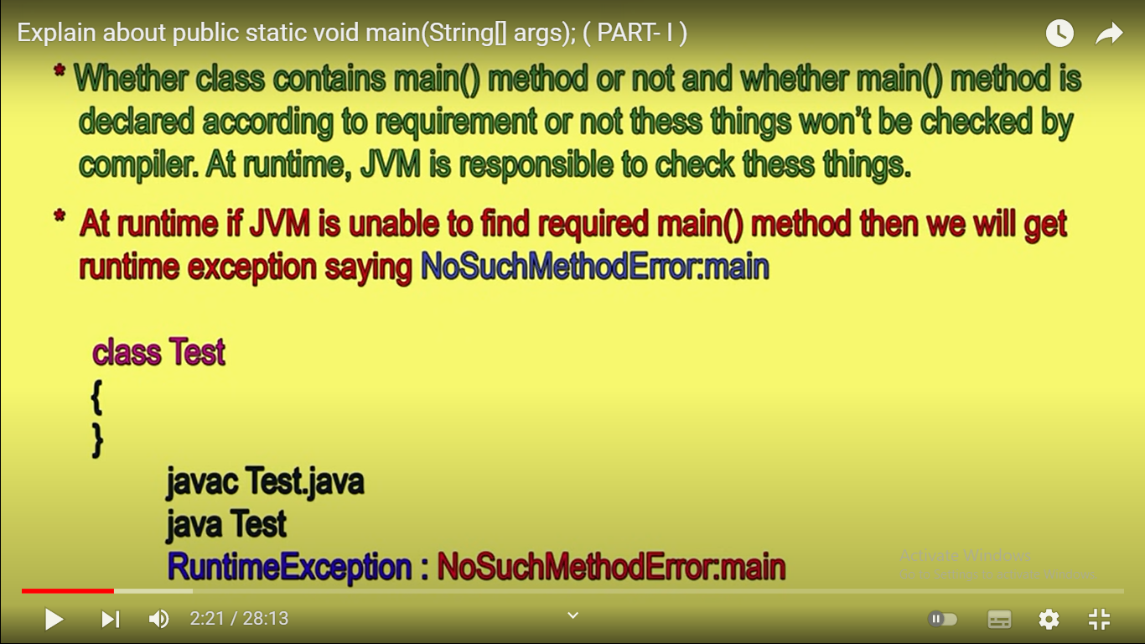

Slide 61
What is the signed data types?

Slide 62
A signed data type uses the first bit to indicate whether it is a positive/negative number. An unsigned data type does not store it’s sign and is usually used for number guaranteed to be positive/negative (such as elapsed time).
.

Slide 63
What is unsigned data types?

Slide 64
An unsigned short (2 bytes) can represent values from 0 to 2^16, while a signed data type can store values form -2^15 to 2^15.

Slide 65
What is the proto types of main method()

Slide 66
Why main() is public?

Slide 67
Why main() is static?

Slide 68
Why main() is void?

Slide 69
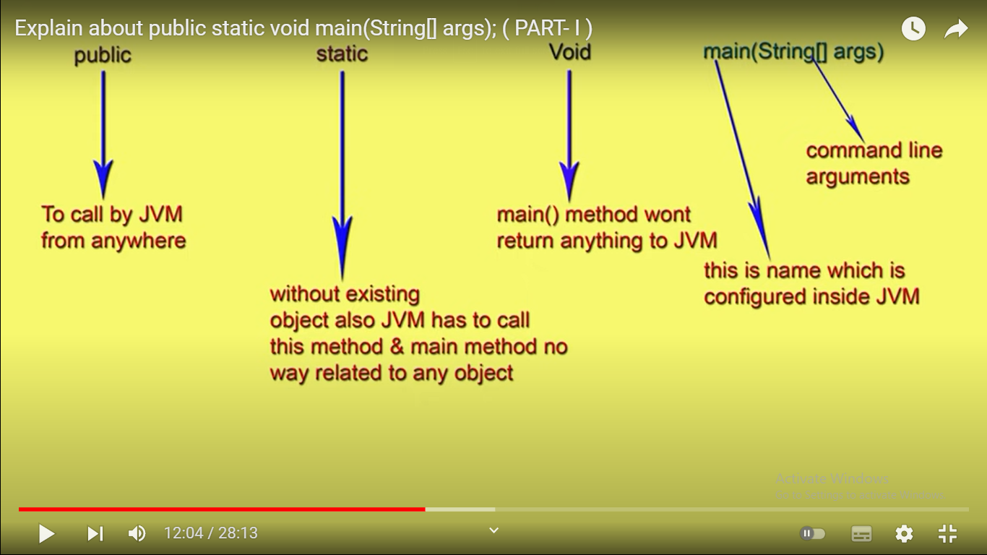

Slide 70
Can we declare main()
static public void main(String[] ags)
{
}

Slide 71
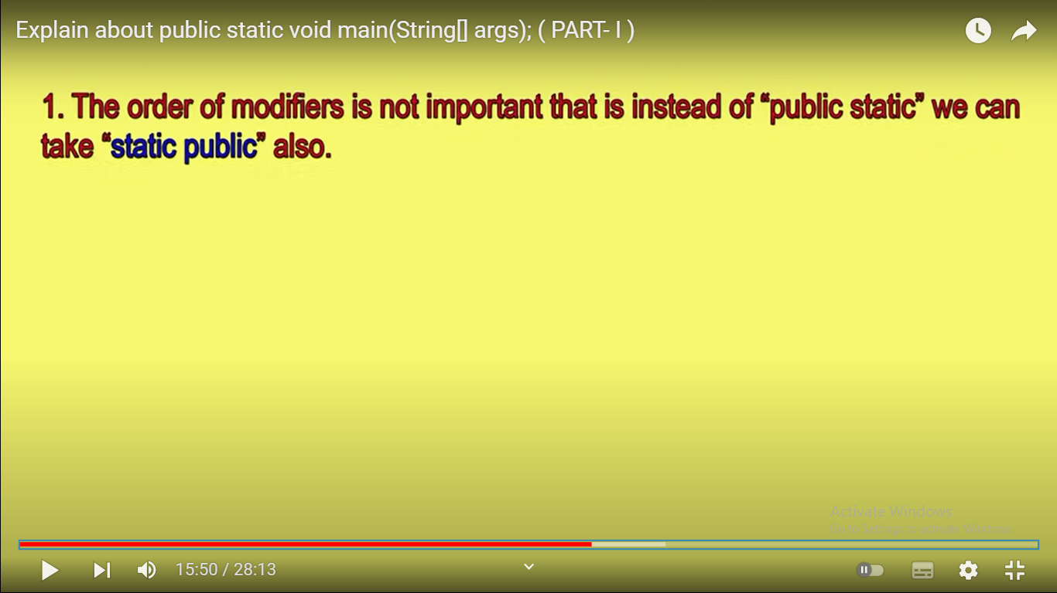

Slide 72
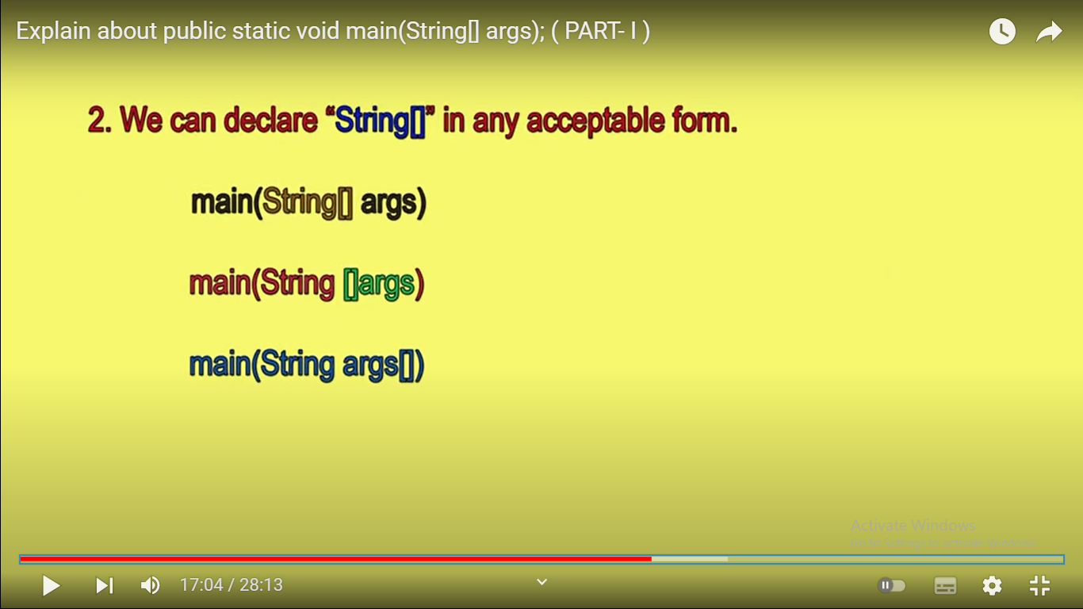

Slide 73
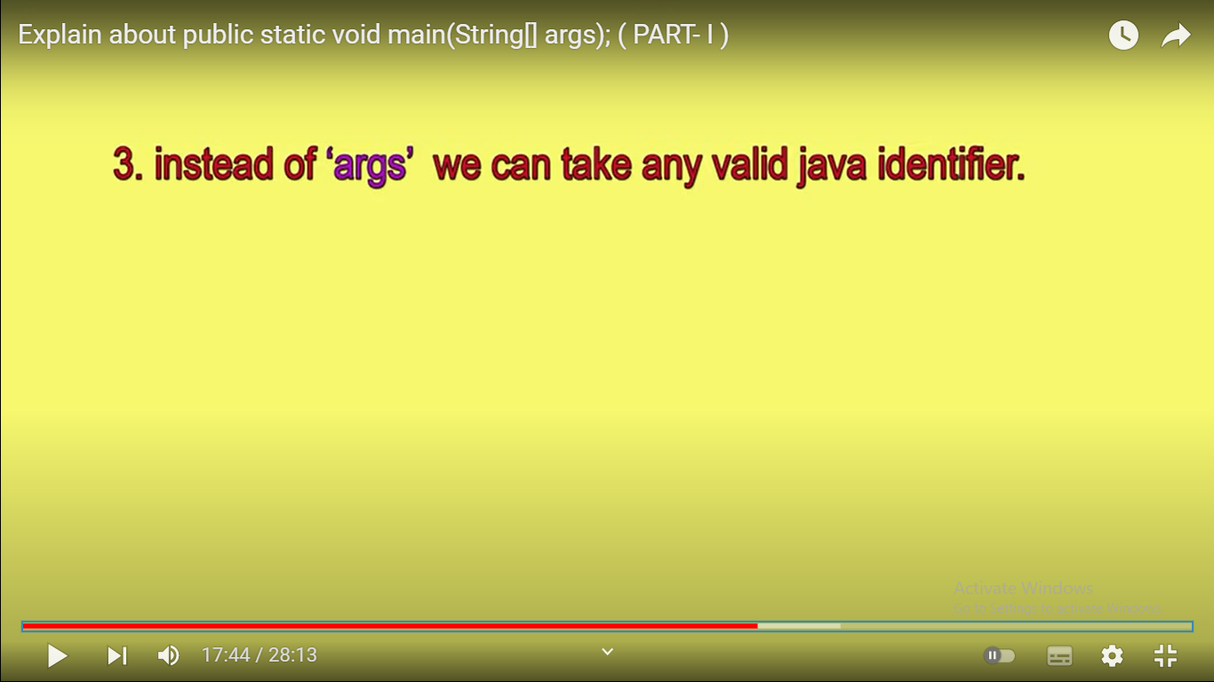

Slide 74
We can replace string array with var arg[]?

Slide 75
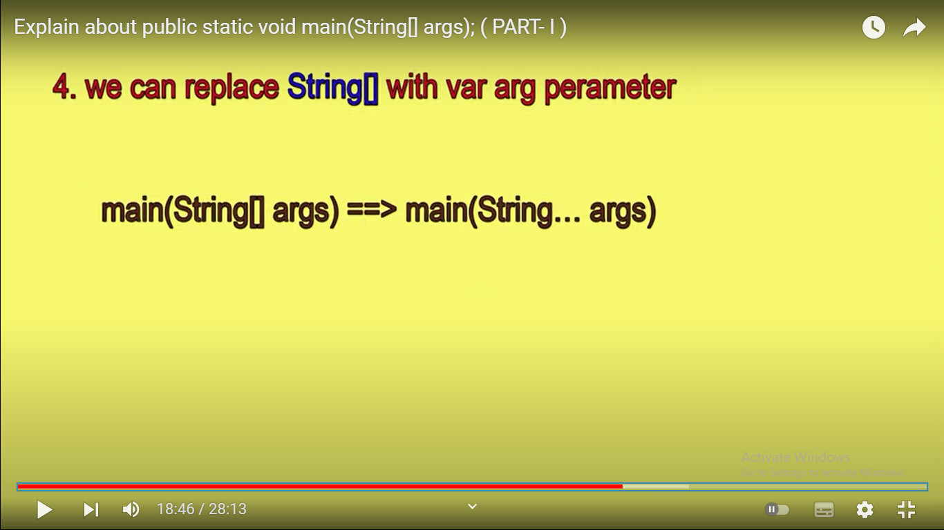

Slide 76
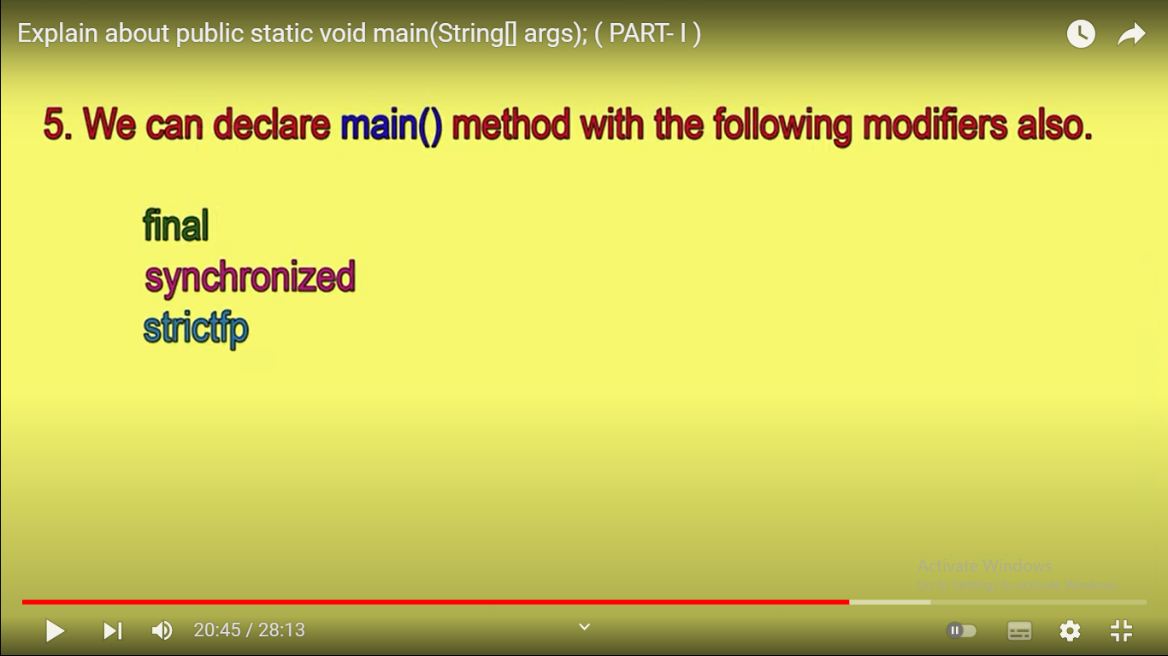

Slide 77
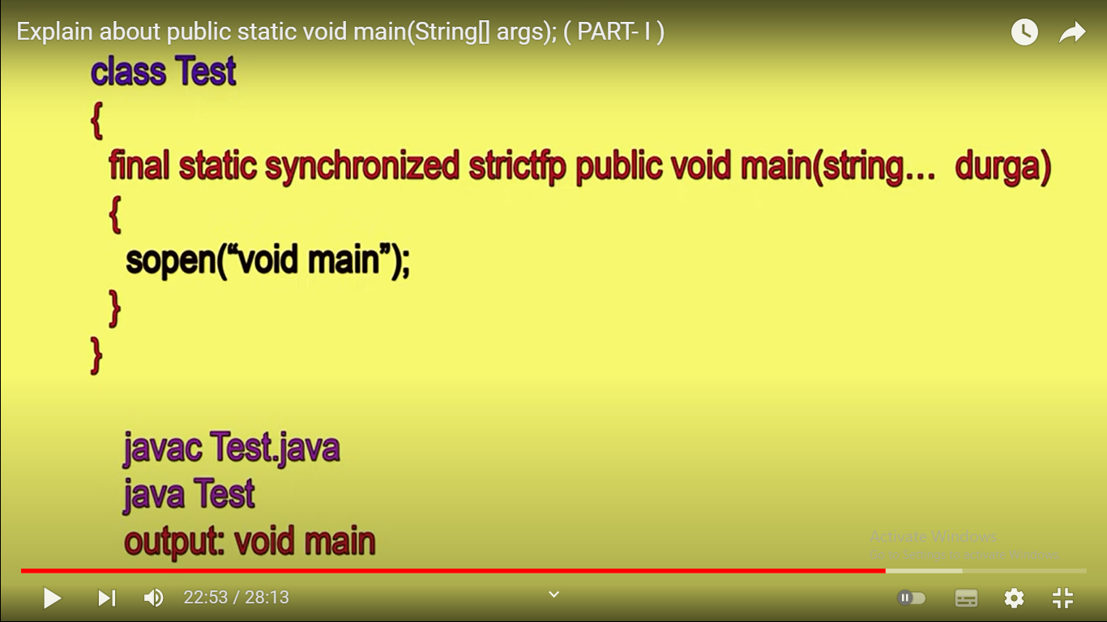

Slide 79
How many Reserved Kewords?

Slide 80
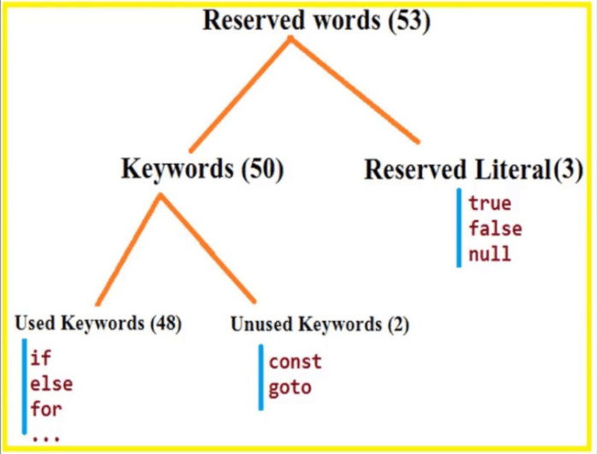

Slide 81
Which is one is the valid keyword in java ?
Interface
String
float
unsigned

Slide 82
Which is one is the reserved valid keyword in java ?
native
method
args
subclass

Slide 83
Which is a valid declarations of a String?
a.String s1 = null;
b.String s2 = 'null';
c.String s3 = (String) 'abc';
d.String s4 = (String) '\ufeed';

Slide 84
Single-line Comments ?

Slide 85
// This is a comment System.out.println("Hello World");

Slide 86
Java Multi-line Comments

Slide 87
Java Multi-line Comments
/* The code below will print the words Hello World to the screen, and it is amazing */ System.out.println("Hello World");

Slide 88
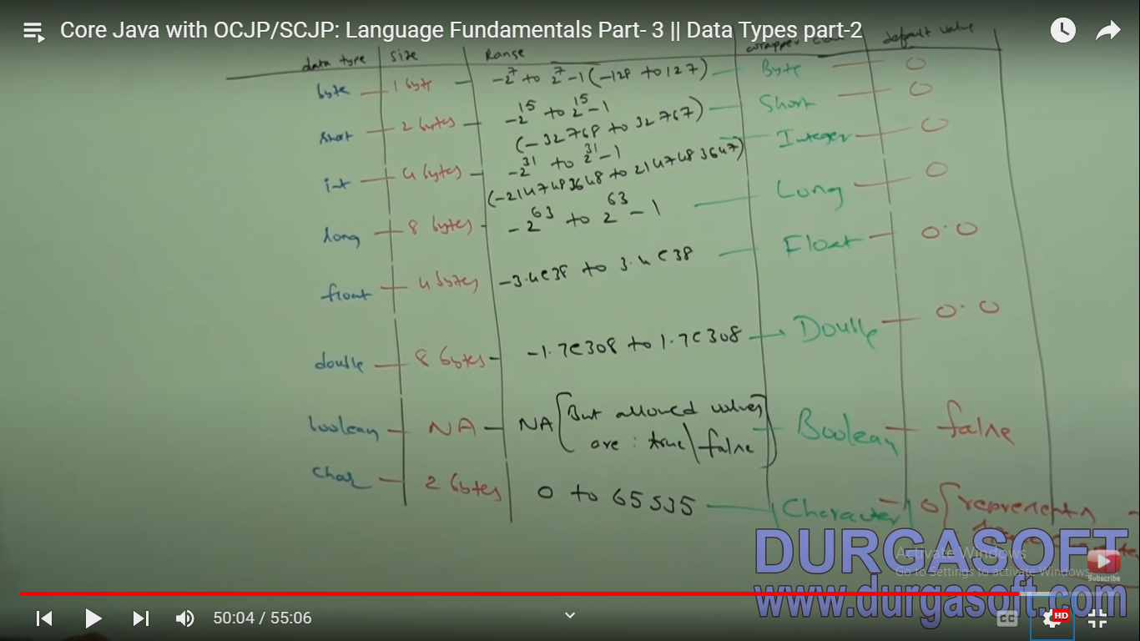

Slide 89
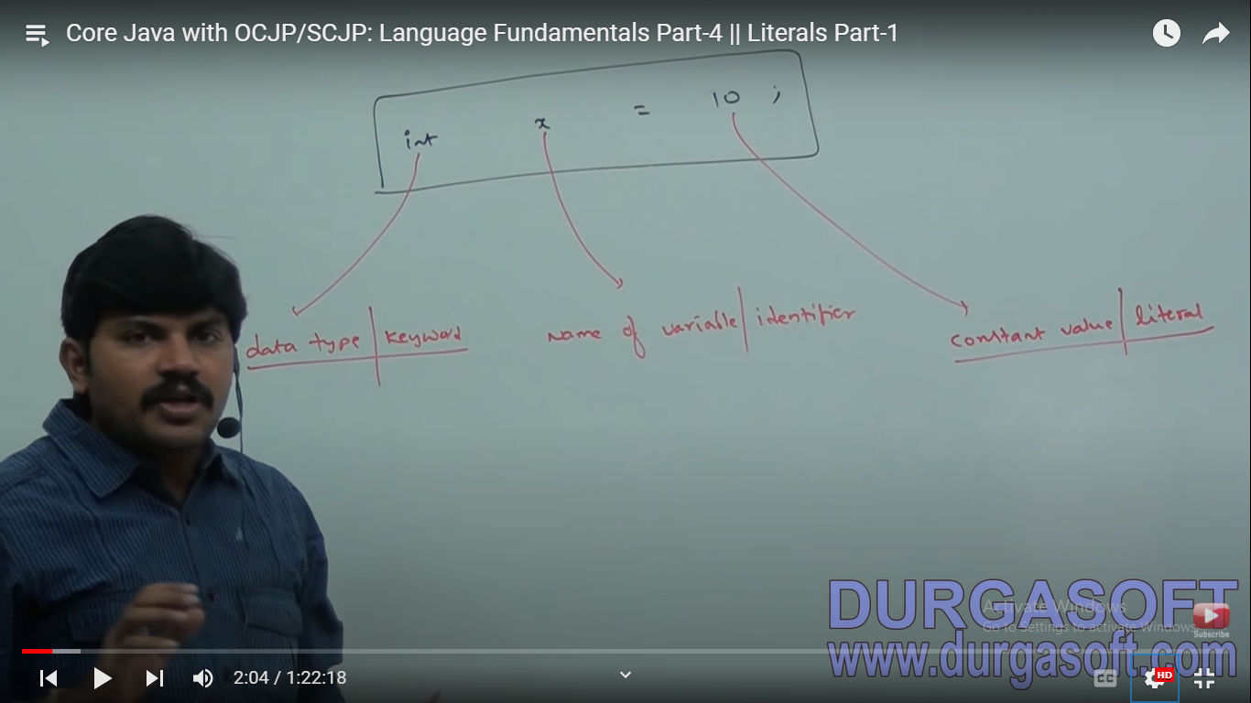

Slide 90
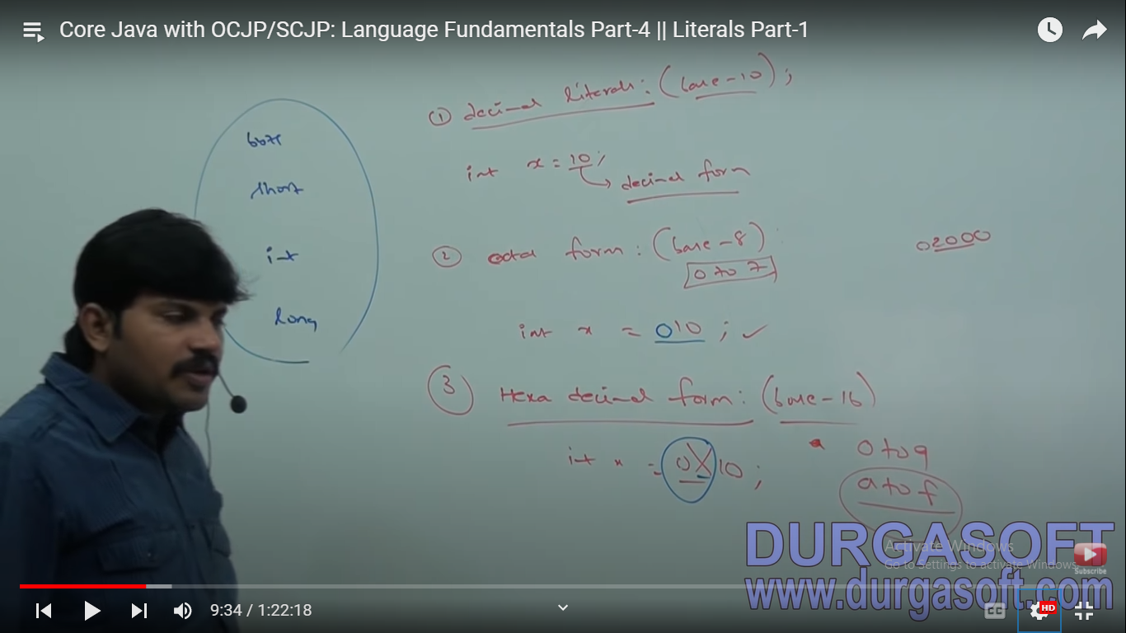

Slide 91
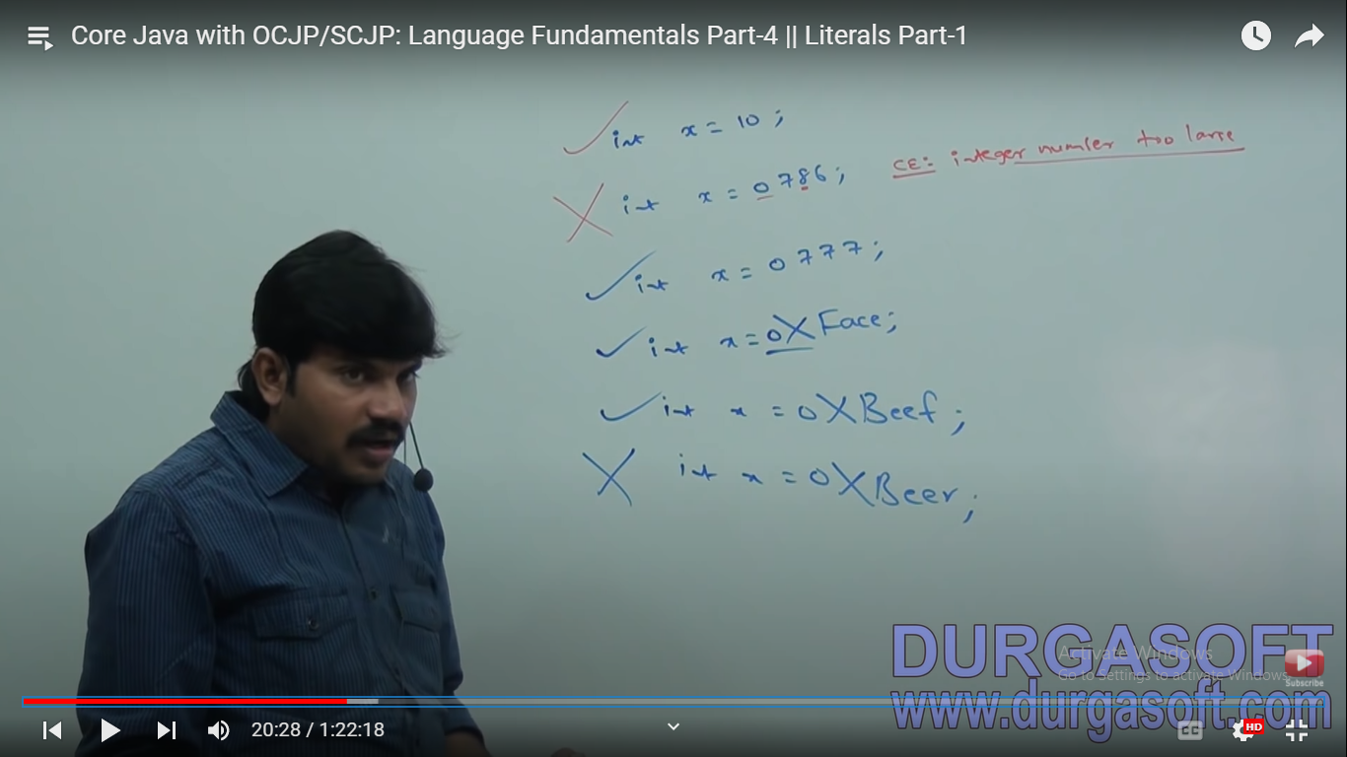

Slide 93
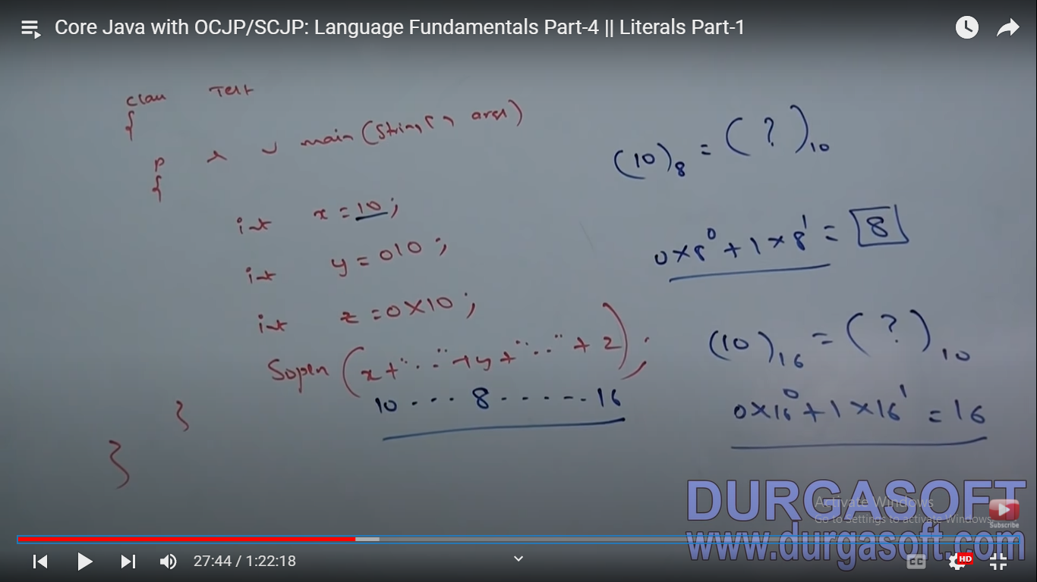

Slide 94
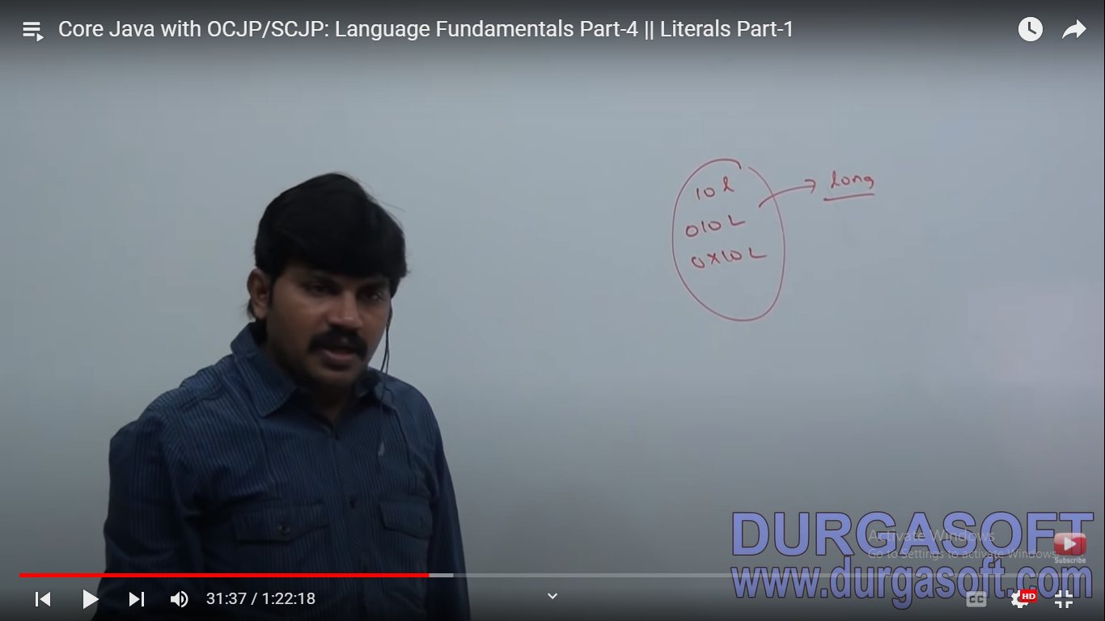

Slide 95
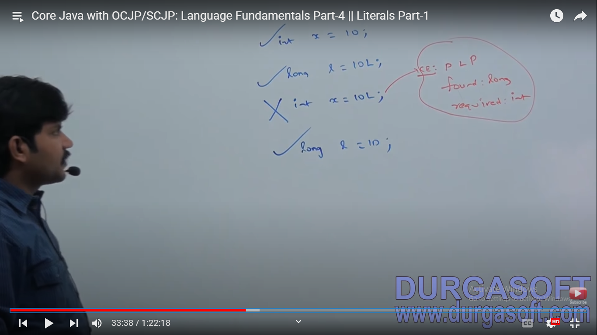

Slide 96
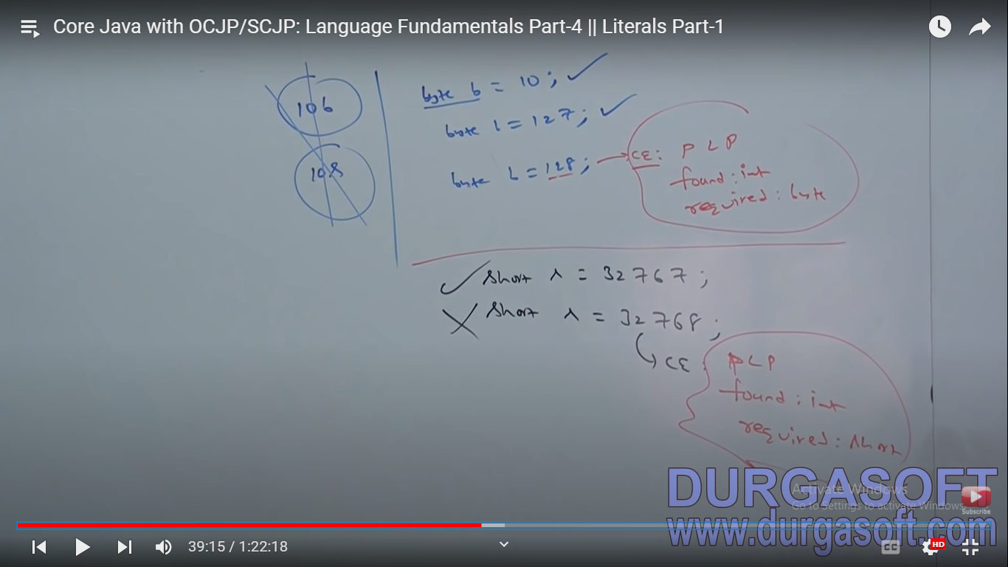

Slide 97
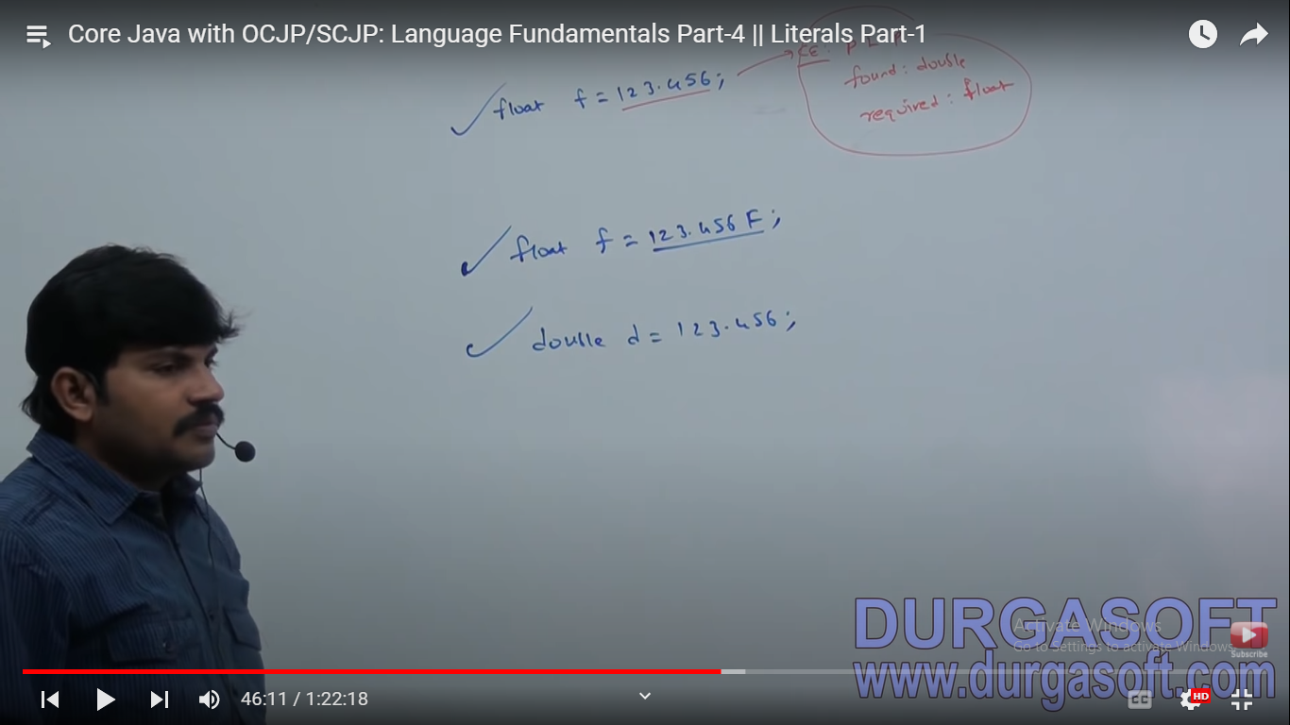

Slide 98


Slide 99
What is Array ?

Slide 100
Array is indexed collection of fixed number of homogenous data elements

Slide 101
Array are advantages ?

Slide 102
We can represent huge number of value by using single variables .
So the readability of code will be improve

Slide 103
What are disadvantages of arrays?

Slide 104
Fixed Sized
Declared sized in advanced

Slide 105
What is nest way to declare array?
int[] x;
int []x;
int x[];

Slide 106
Can we specify size of array at the time of declaration?
int[6] x;
int[] x;

Slide 107
Which of the following is write?
int [ ] a,b; a-1 b-1
int [ ] a[ ],b; a-2 b-1
int [ ] a[ ],b[ ]; a-2 b-2
int [ ] []a,b; a-2 b-2
int[ ] a[ ],b[ ]; a-2 b-2
int [ ] [ ]a,b[]; a-2 b-3
Int [ ] [ ]a,[ ]b; CE:

Slide 108
Array is object?

Slide 109
What is the output?
int [ ] a =new int[3];
System.out.println(a.getClass.getclassName());

Slide 110
Output:
[I
[[I

Slide 112
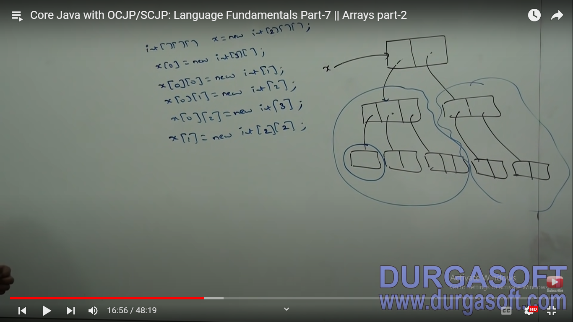

Slide 113
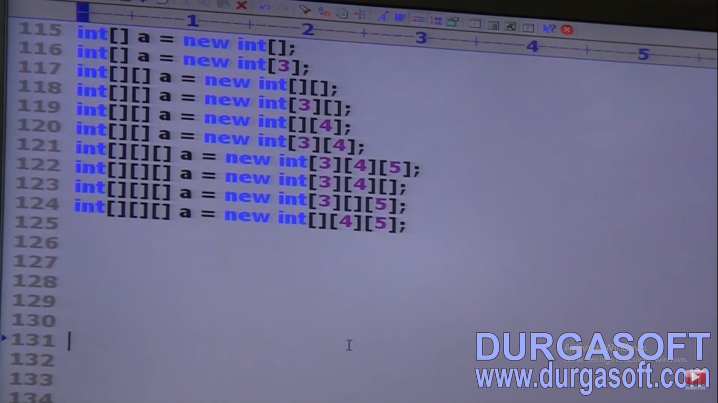

Slide 114
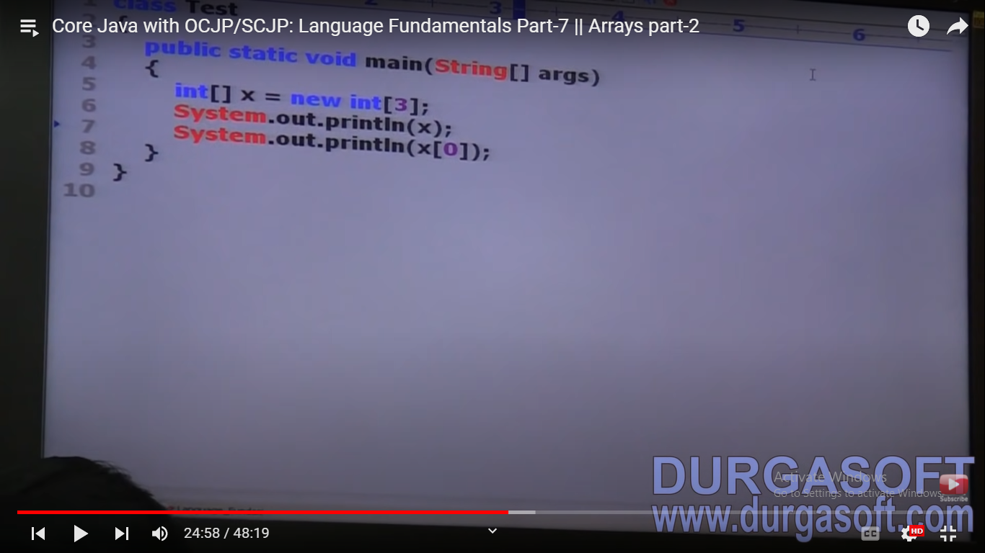

Slide 115
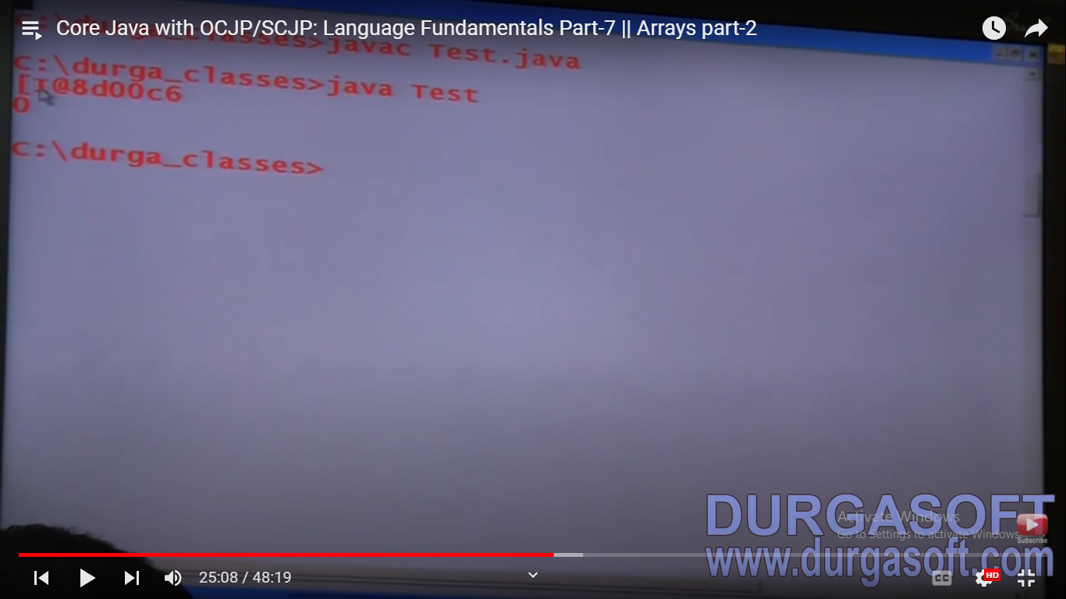

Slide 116
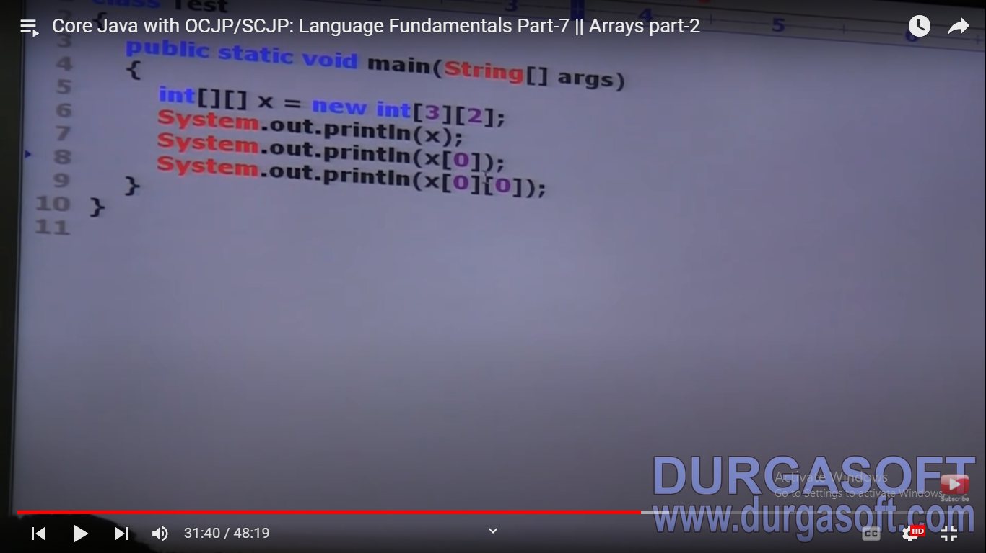

Slide 117
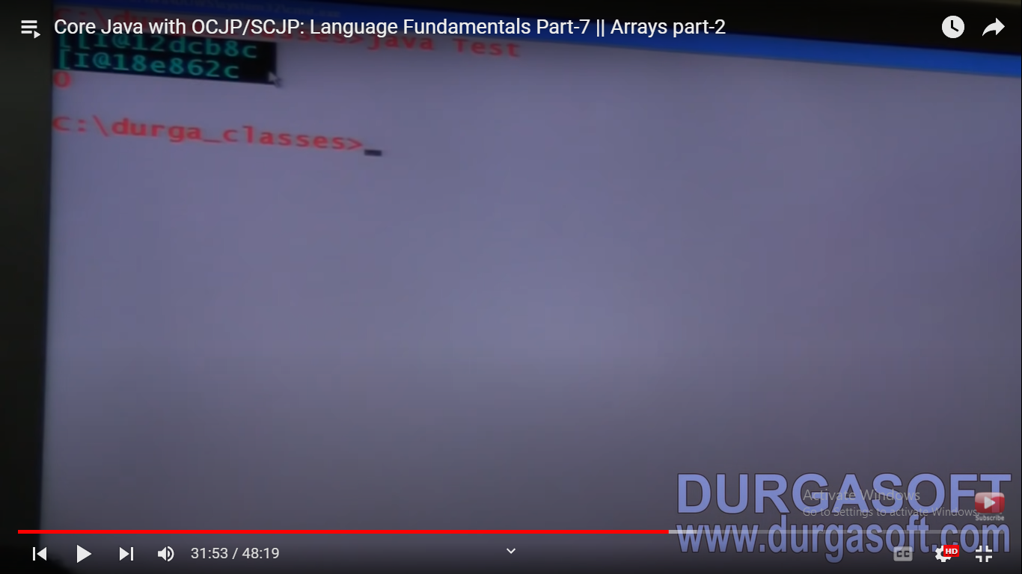

Slide 118
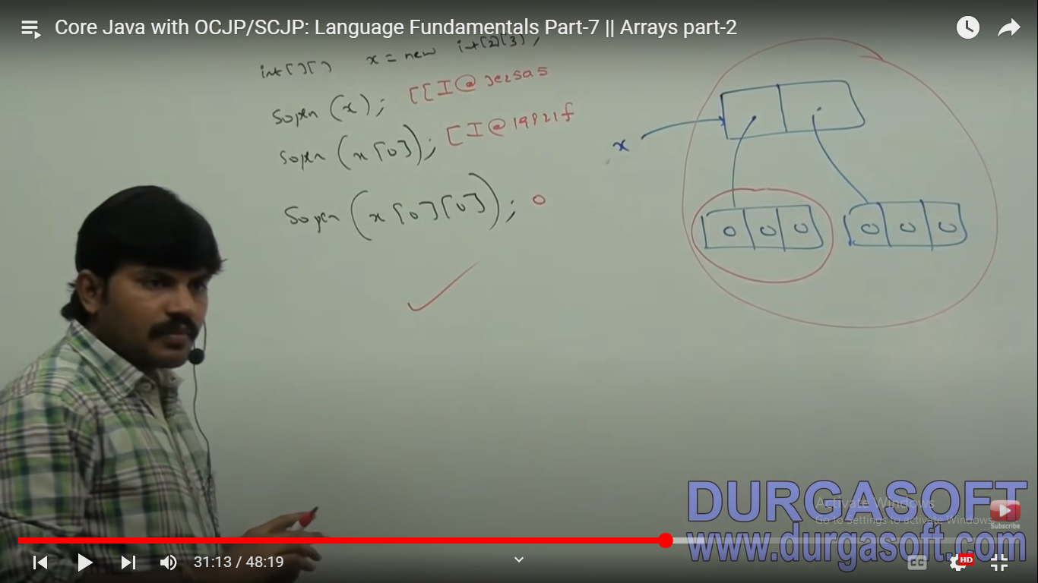

Slide 119
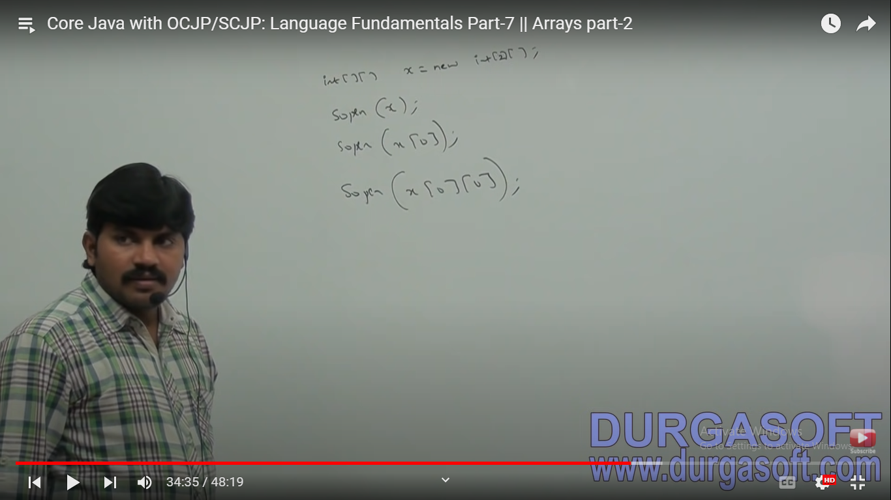

Slide 120
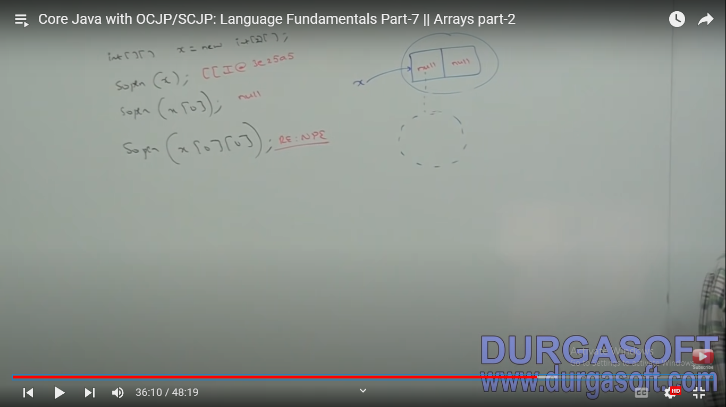

Slide 121
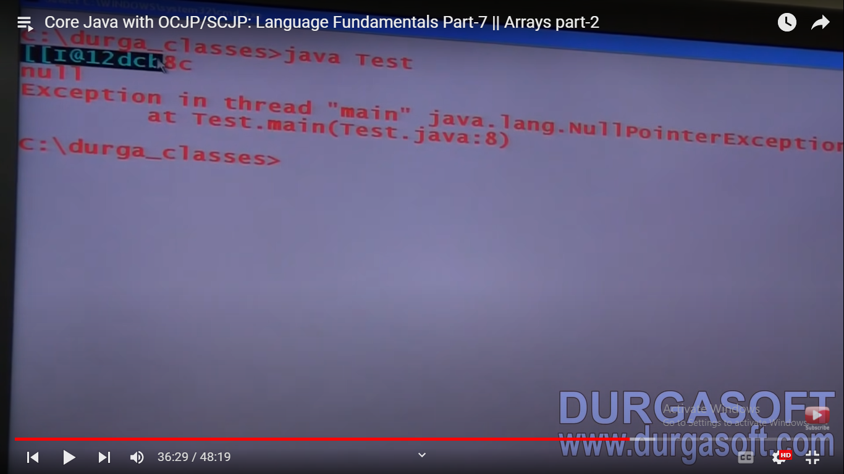

Slide 122
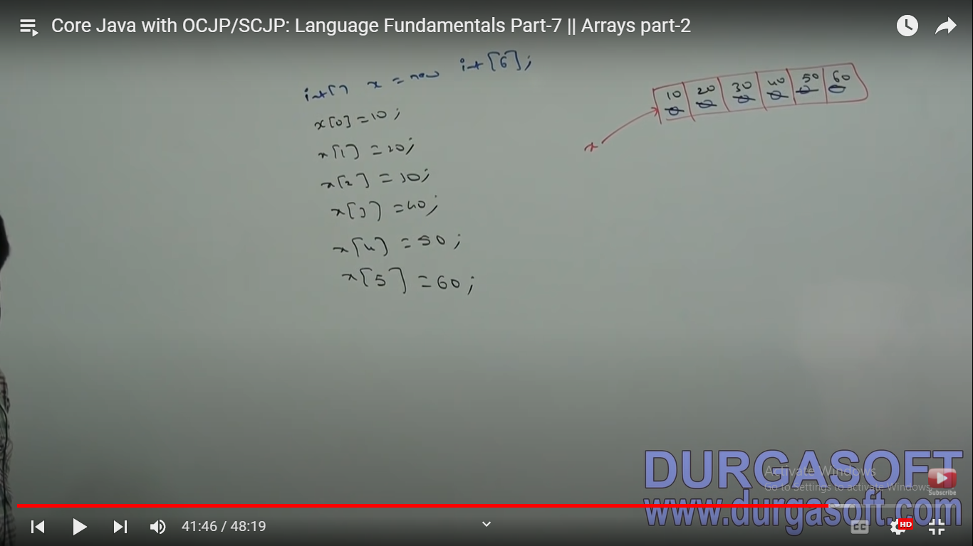

Slide 123
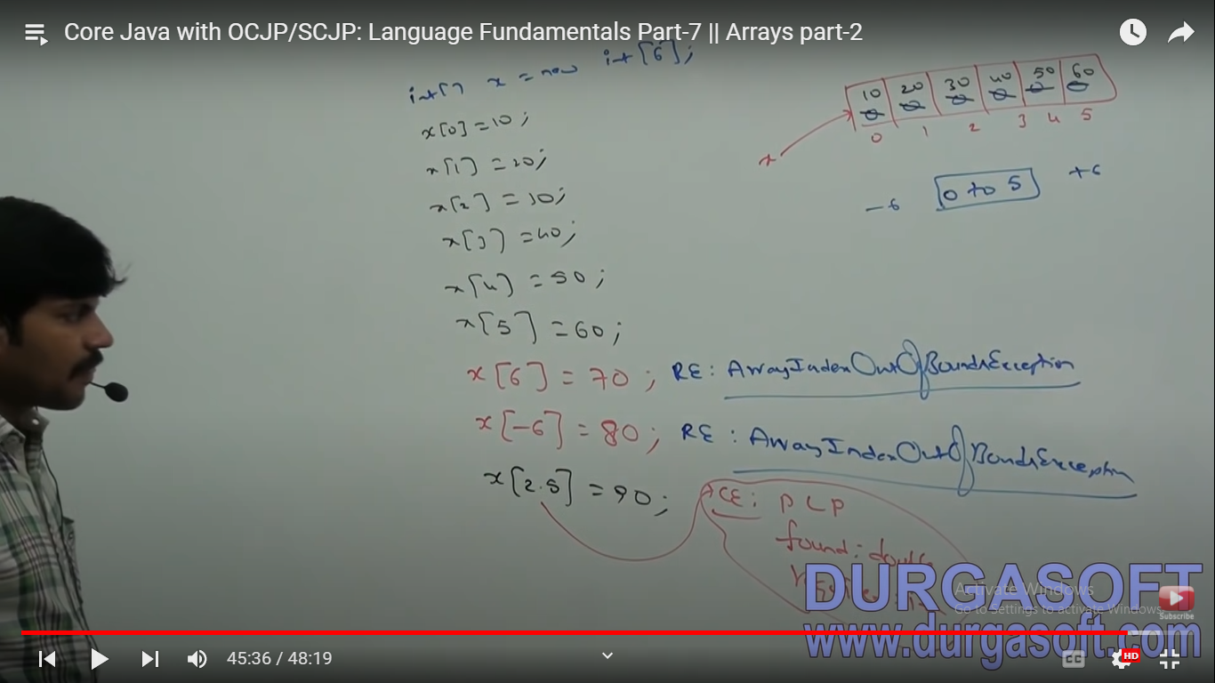

Slide 124
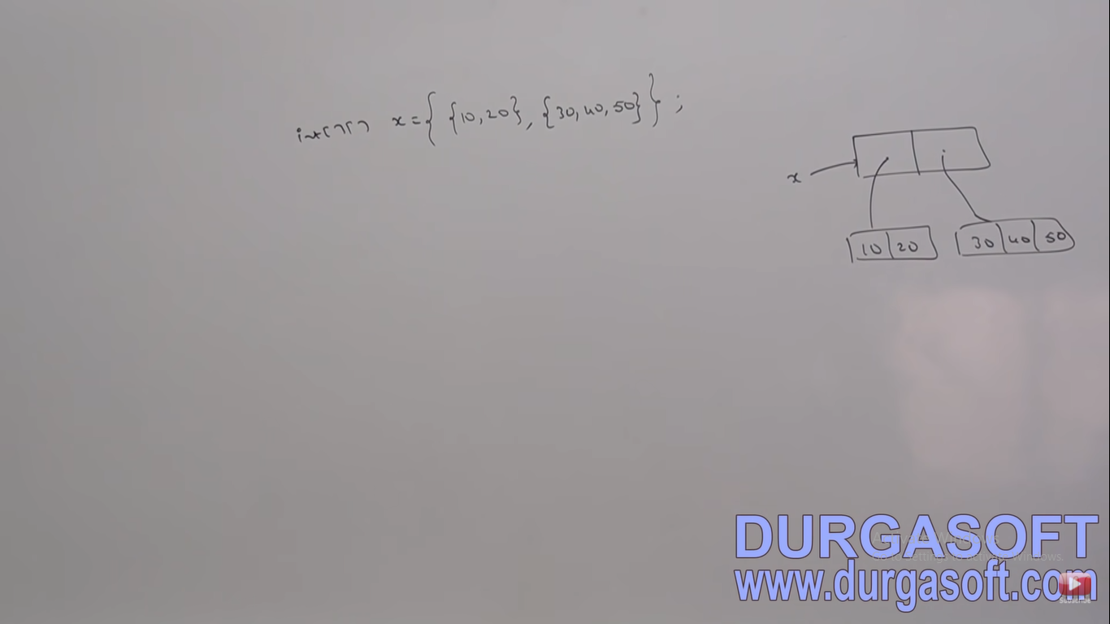

Slide 125
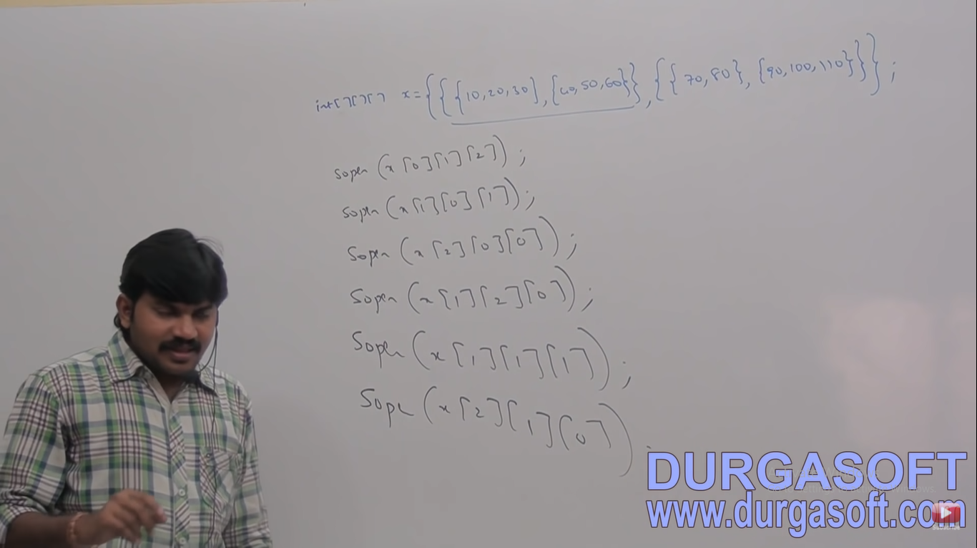

Slide 126
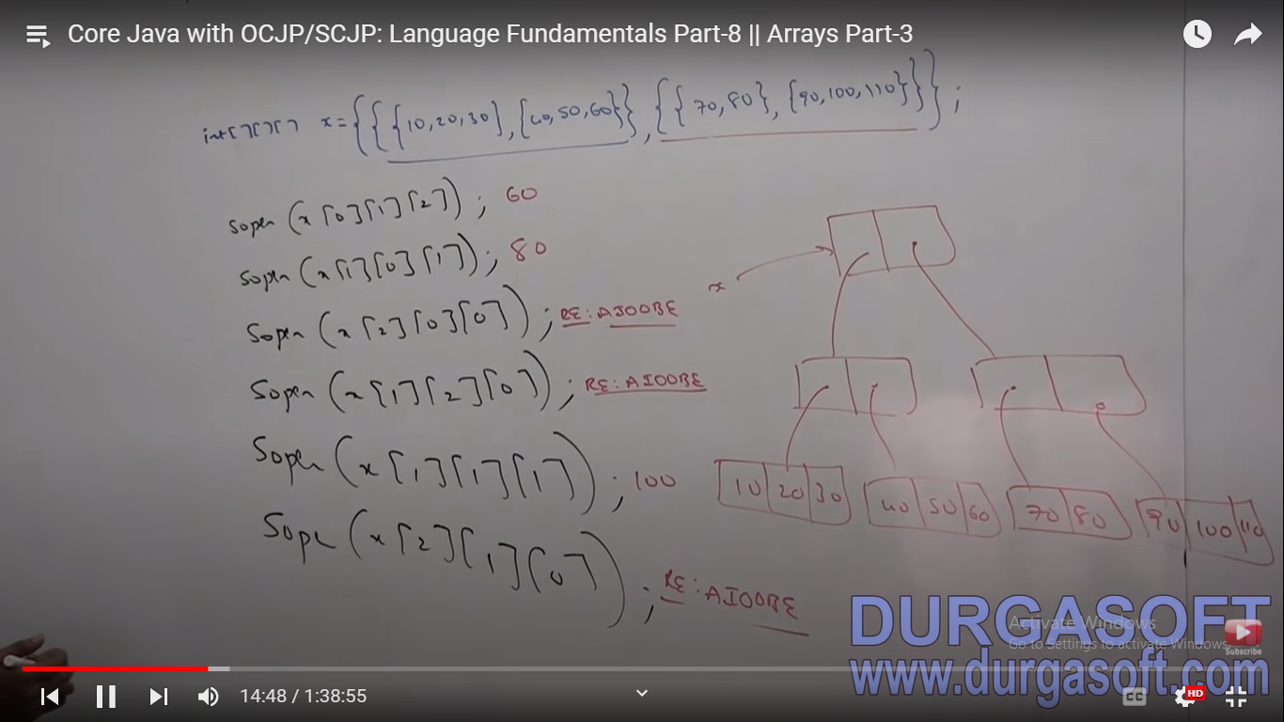

Slide 127
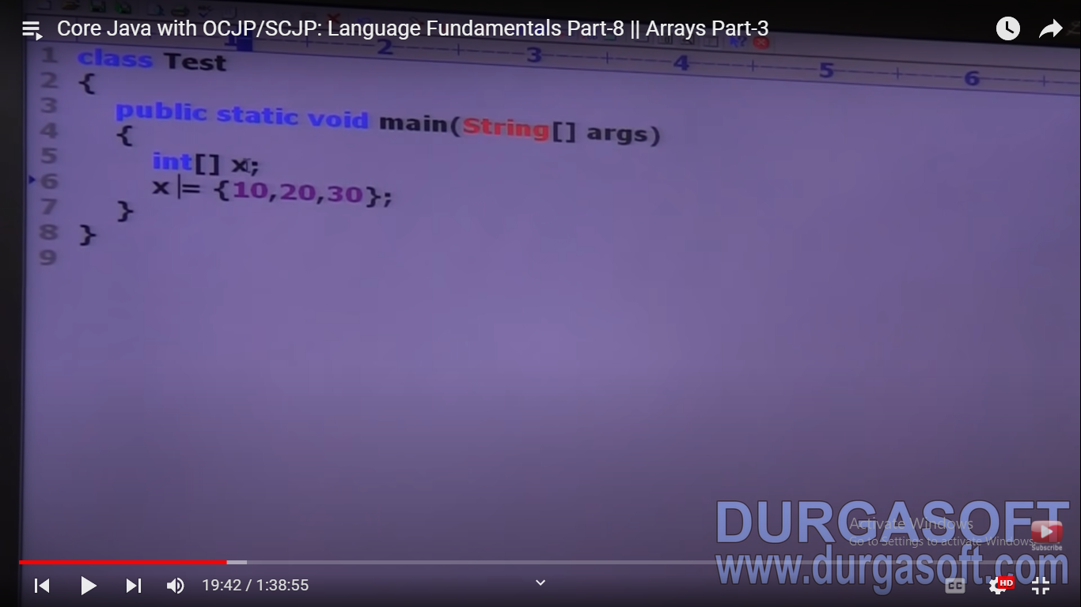

Slide 128
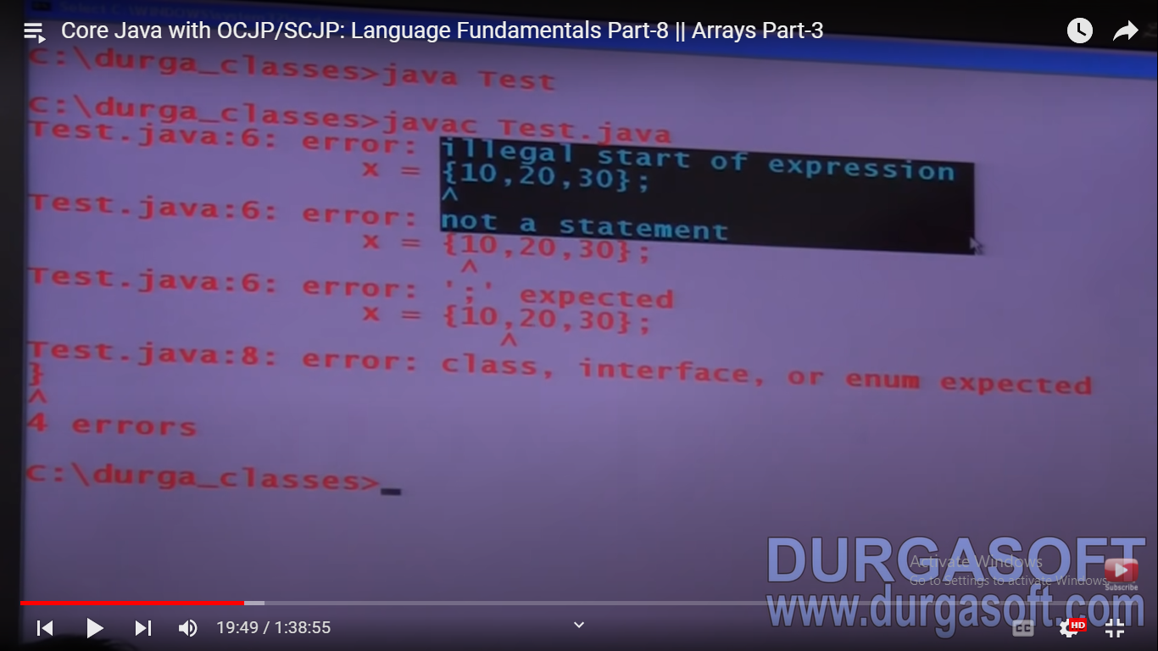

Slide 129
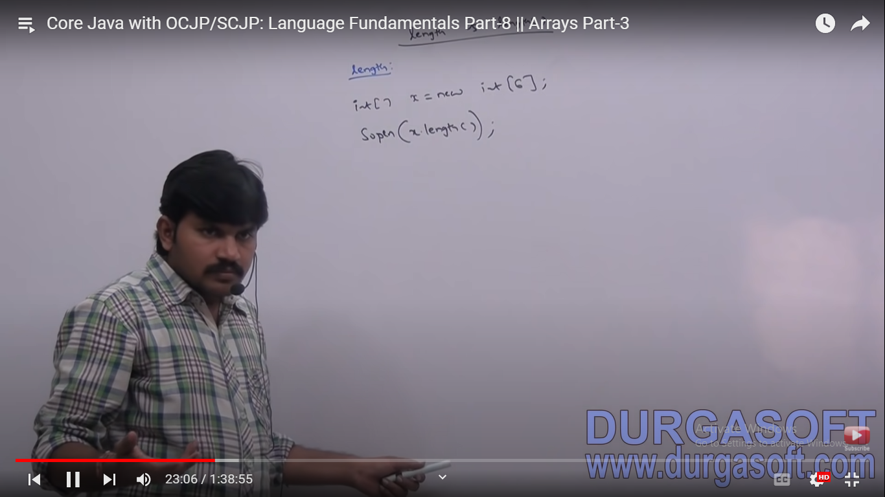

Slide 130
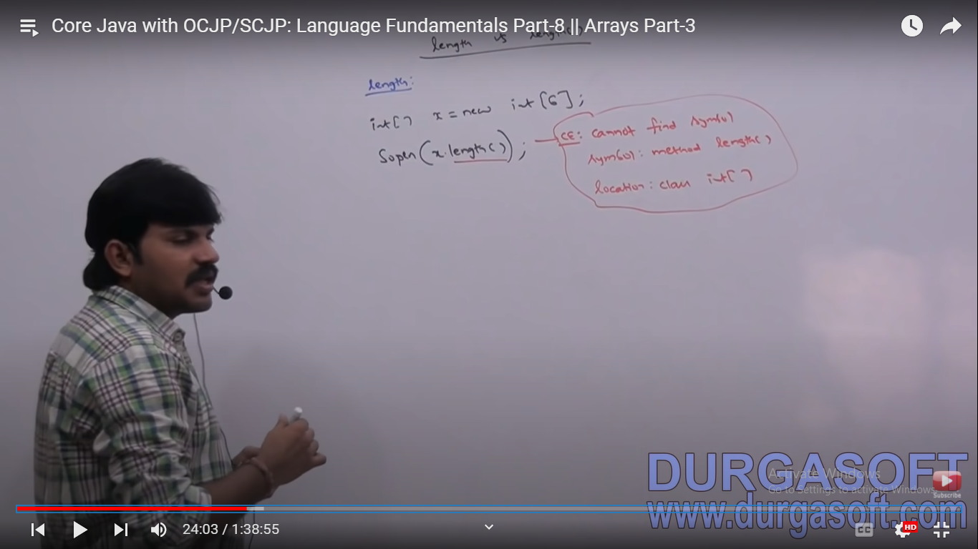

Slide 131
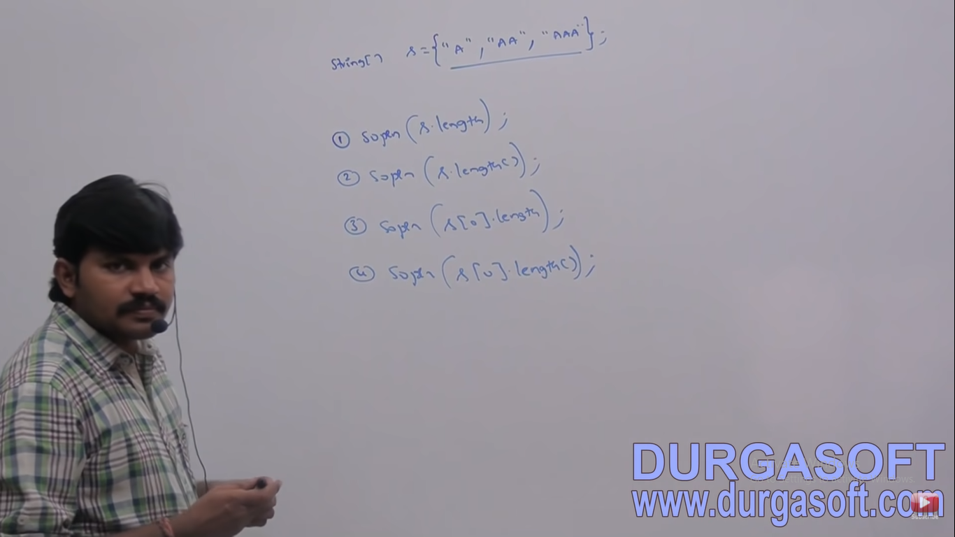

Slide 132
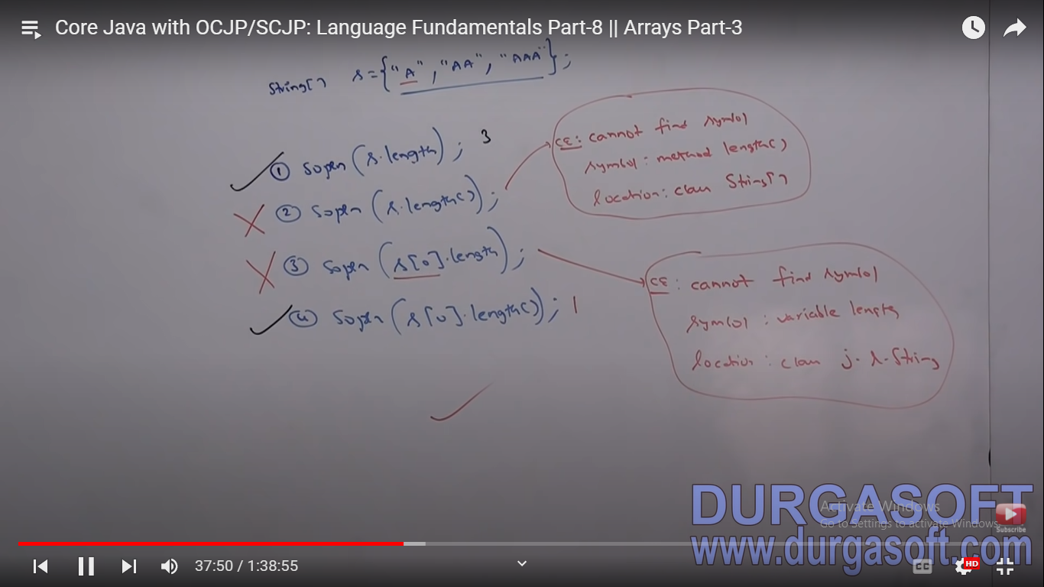

Slide 133
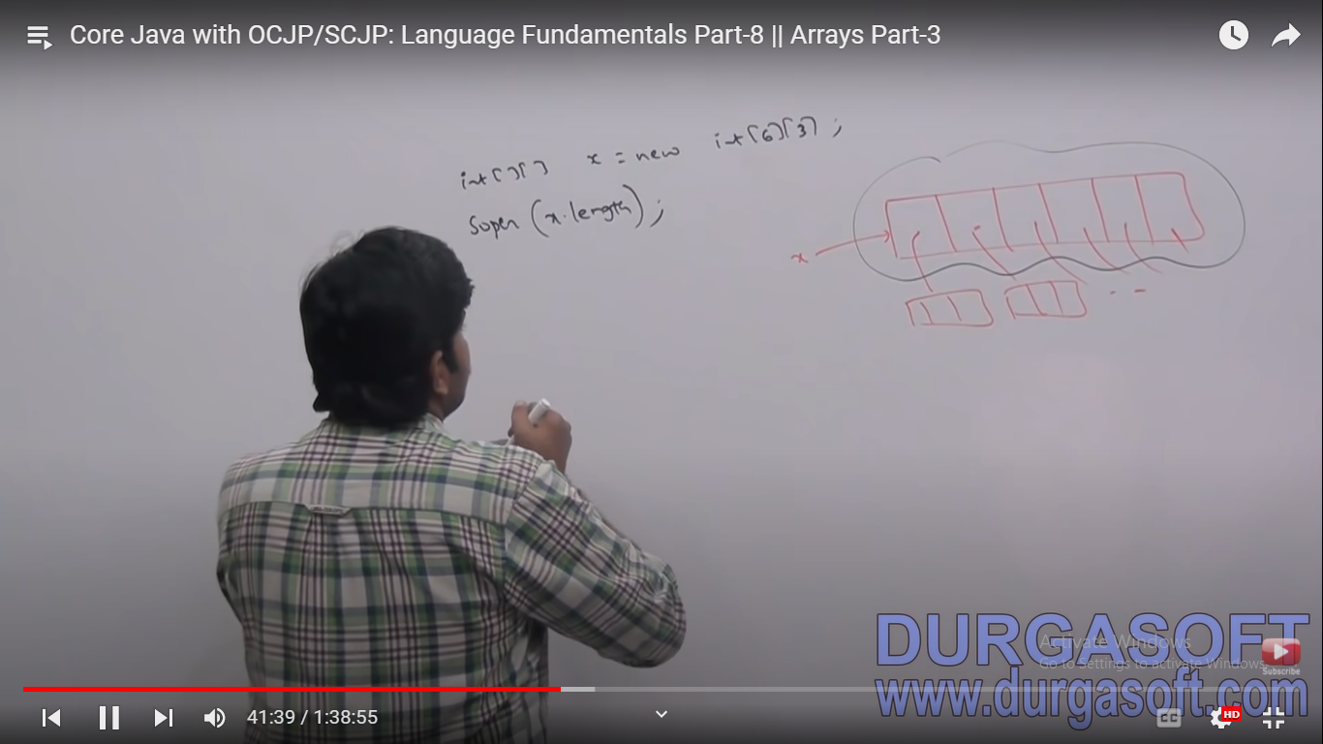

Slide 134
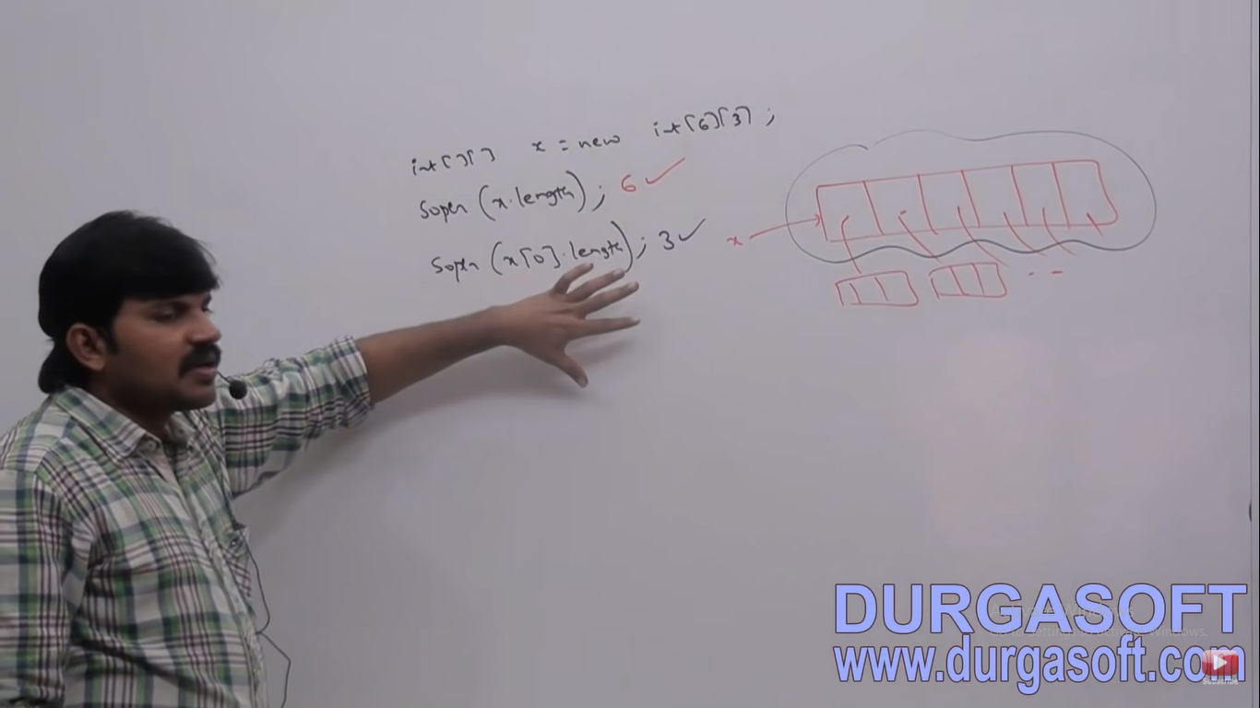

Slide 135
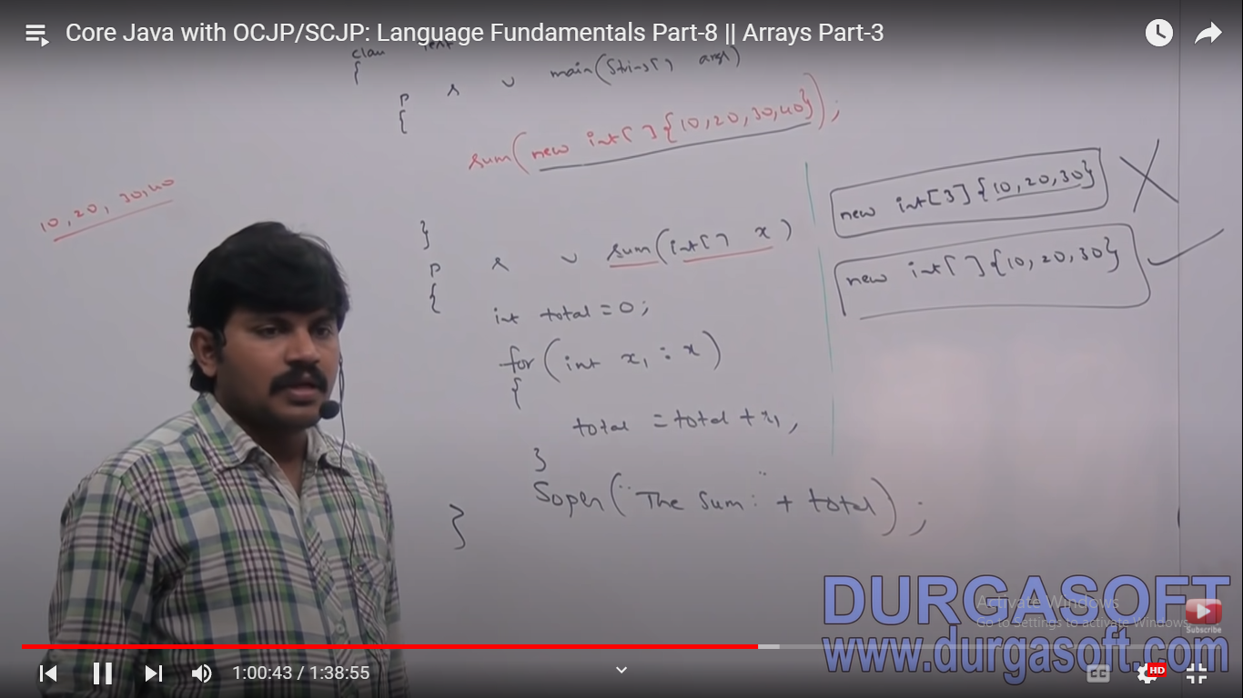

Slide 136
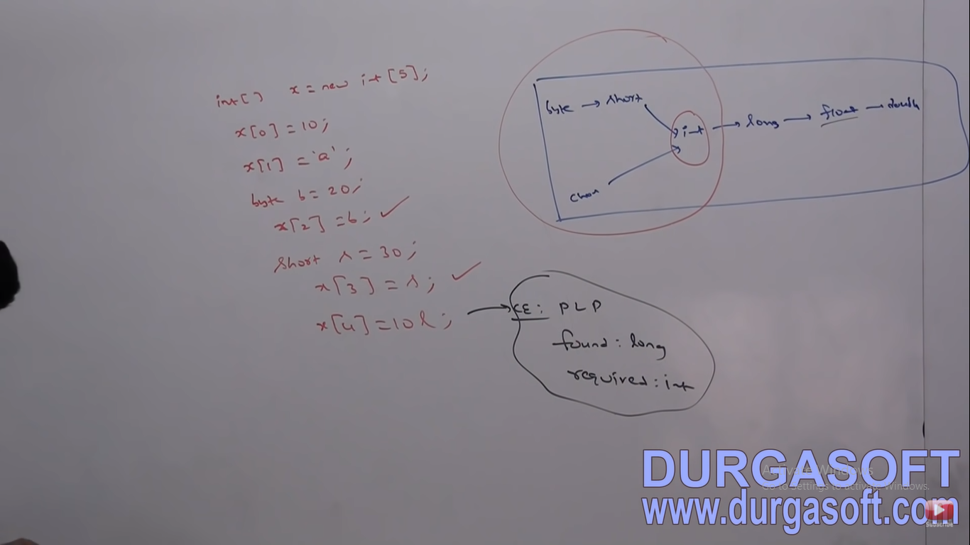

Slide 137


Slide 138
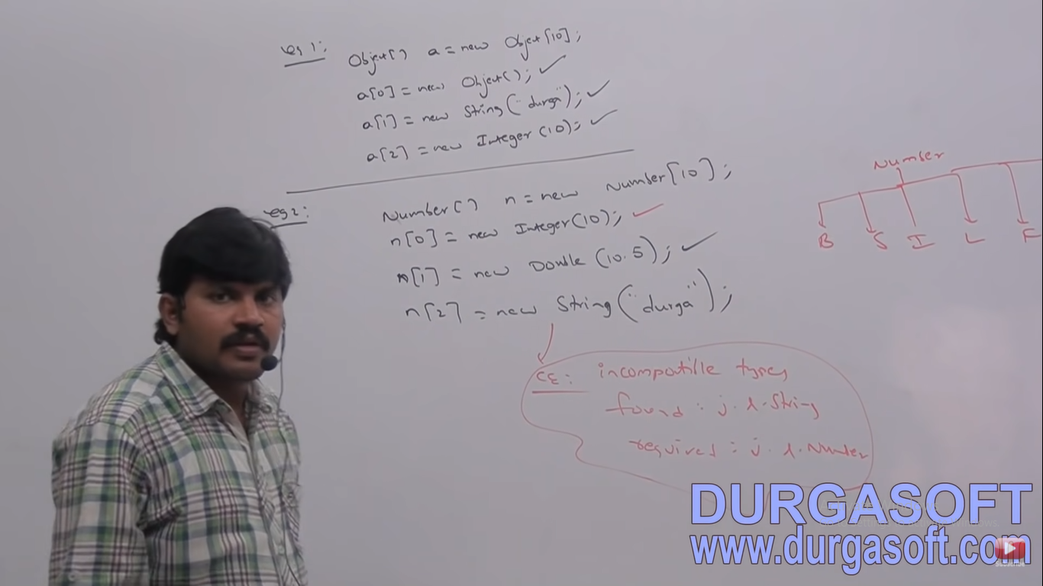

Slide 139
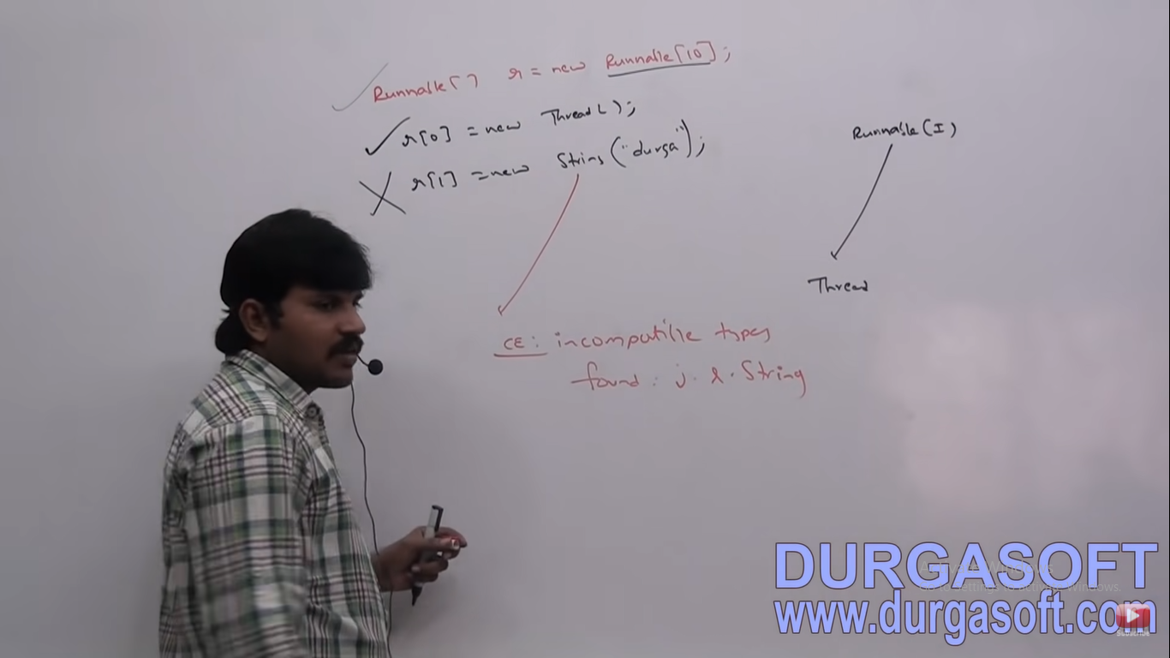

Slide 140
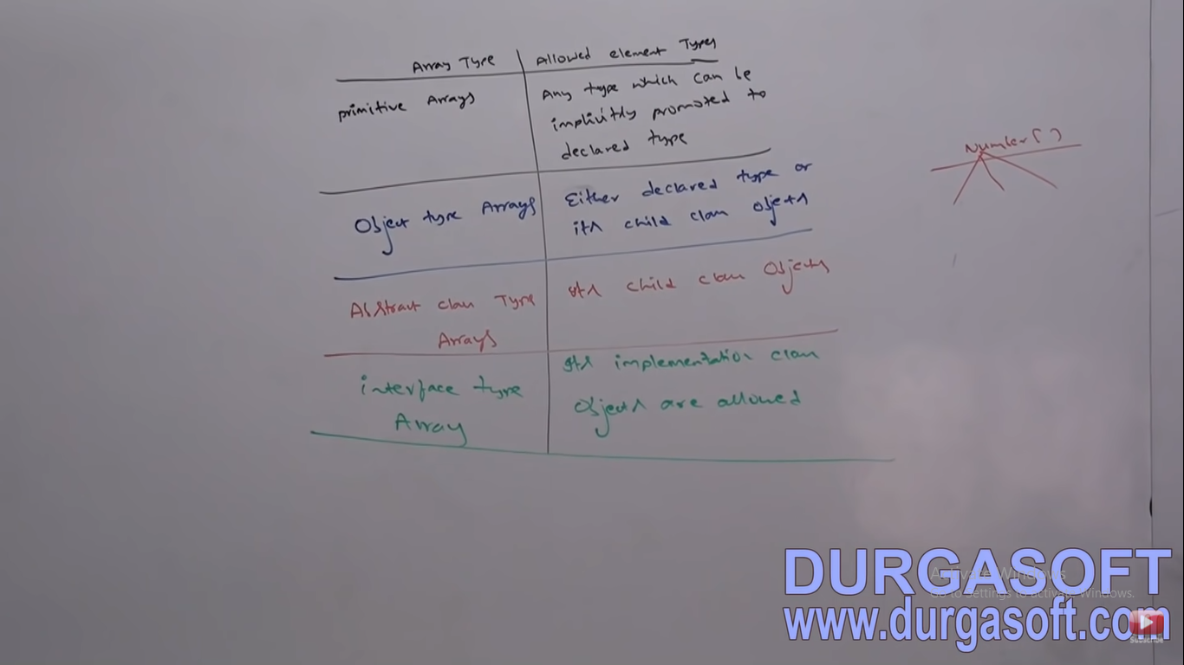

Slide 141
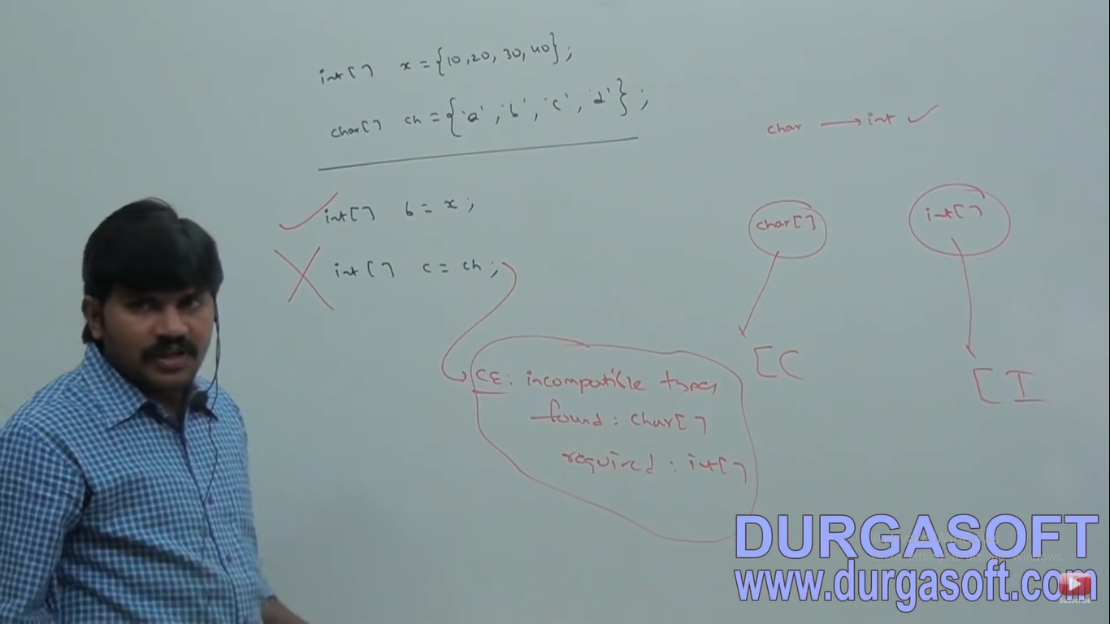

Slide 142
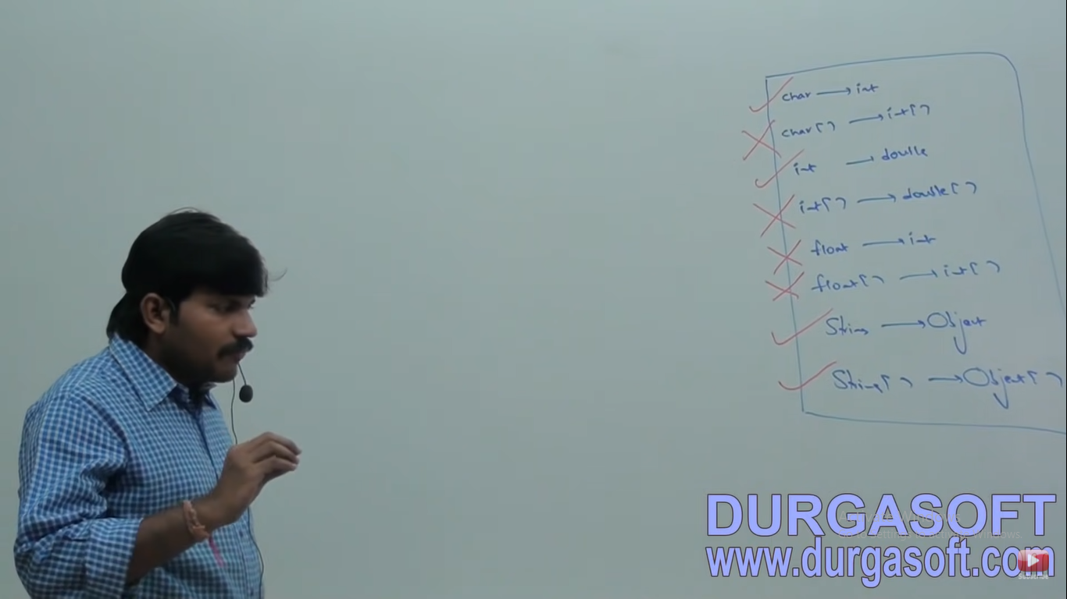

Slide 143
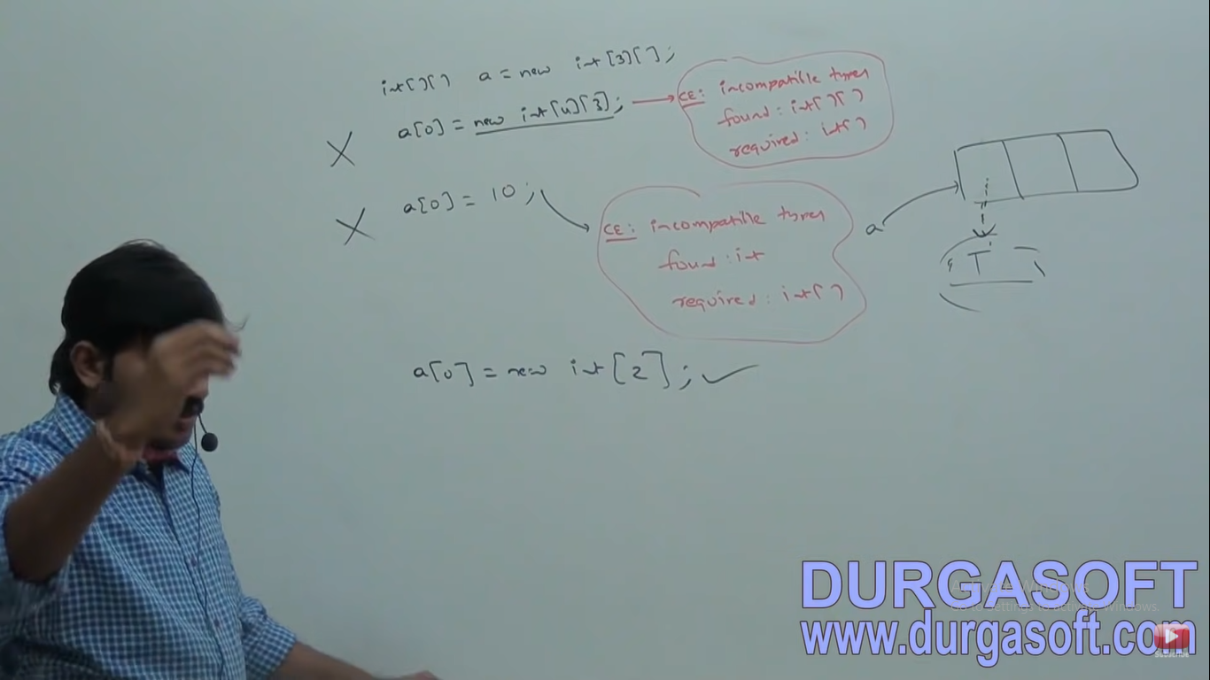

Slide 144
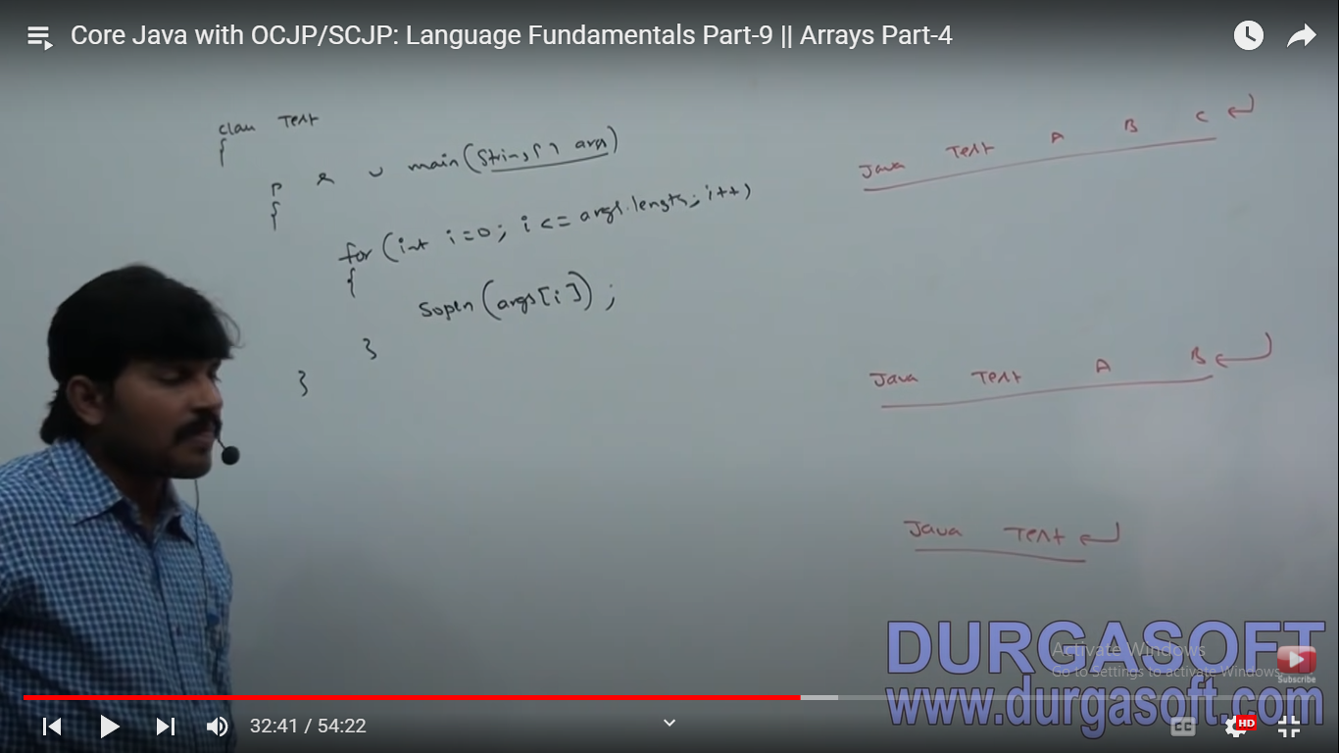

Slide 145


Slide 146


Slide 147


Slide 148


Slide 149


Slide 150


Slide 151


Slide 152


Slide 153


Slide 154


Slide 155


Slide 156


Slide 157


Slide 158


Slide 159


Slide 160


Slide 161


Slide 162


Slide 163


Slide 164


Slide 165


Slide 166


Slide 167


Slide 168


Slide 169


Slide 170


Slide 171


Slide 172


Slide 173


Slide 174


Slide 175


Slide 176


Slide 177


Slide 178


Slide 179


Slide 180


Slide 181


Slide 182


Slide 183


Slide 184


Slide 185


Slide 186


Slide 187


Slide 188


Slide 189

Which is one is the valid var arg method?

Slide 190


Slide 191


Slide 192
Can we mix var arg parameter with grrneral parameter?

Slide 193


Slide 194
Var arg parameter should me last parameter?

Slide 195


Slide 196
Can we take more than one var arg parameters?

Slide 198


Slide 199


Slide 200

What is the output?

Slide 201


Slide 202
Can we replace one dimension array with var arg ?

Slide 203


Slide 204
Can we change var arg () to main()?
Public static void main(String[] args)
{
}
Public static void main(String… vrgs)
{
}

Slide 205
Can we reverse var arg () to one [] aray?

Slide 206


Slide 207


Slide 208


